Slide 1
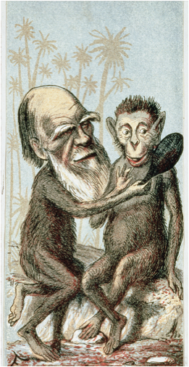
Chapter 24
The Birth of Modern European Thought

Slide 2
Advances in Reading and Primary Education
By 1900 there was a 85% literacy rate in Britain, France, Belgium, Netherlands, Germany, and Scandinavia
Due to improvements in primary education
Led to greater secondary education opportunities
There were far lesser rates in Italy, Spain, Russia, Austria-Hungary and the Balkans
Literacy rose as governments enacted educational reforms
More men could read than women, more urbanites could read than rural dwellers
Higher literacy in western Europe than southern or eastern Europe
Literacy enables Europeans to gain knowledge and improve their social situations
Education Act of 1870 – England placed education in the hands of the State and established school boards in districts without Anglican Church schools

Slide 3
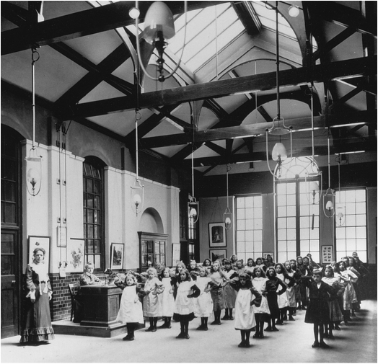
Public education became widespread in Europe during the second half of the nineteenth century and women came to dominate the profession of school teaching, especially at the elementary level. This 1905 photograph shows English schoolchildren going through morning drills.
Notes:
Public education became widespread in Europe during the second half of the nineteenth century and women came to dominate the profession of school teaching, especially at the elementary level. This 1905 photograph shows English schoolchildren going through morning drills.
© Hulton-Deutsch Collection/CORBIS

Slide 4
Reading Material
Number of newspapers, books, magazines, mail-order catalogs, and libraries grow rapidly
Sometimes the publications were mediocre catering to sensationalism, scandal, and pornography
Still, new reading materials led to a popularization of knowledge

Slide 5
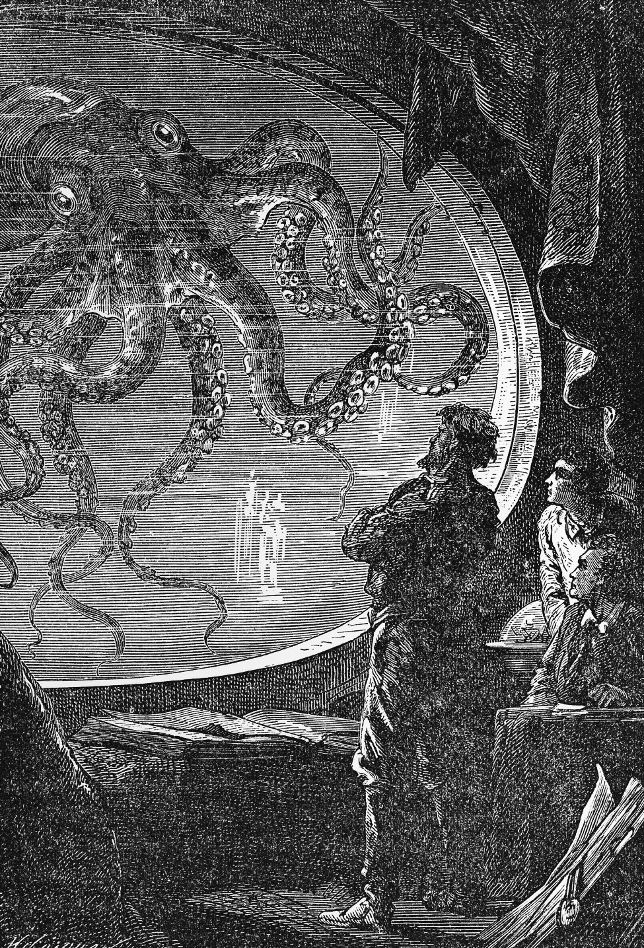
Jules Verne (1828 – 1905) –
popular science fiction fantasies
– Reflected fascination with
developing sciences like
geography, astronomy, physics, as
well as transportation and
communication
– Around the World in 80 Days
(1873) – best seller
Captain Nemo’s submarine confronts a giant octopus in Verne’s Twenty Thousand Leagues under the Sea.
Notes:
Captain Nemo’s submarine confronts a giant octopus in Verne’s Twenty Thousand Leagues under the Sea.
© Bettman/CORBIS

Slide 6
Charles Baudelaire (1821-67)
“Poet of life”
Les Fleurs du Mal (1857)
Believed art was an exchange between the artist’s own life and self-discovery was critical
Arrested for “obscene or immoral passages”
Wrote about the transformation of urban society

Slide 7
Social Theorists
Doctors diagnosed more cases of hypochondria, melancholy & hysteria
Alcoholism was problematic
In France, the average person consumed more than 60 gallons of wine per year!
The use of opium, morphine, laudanum (wine & opium), heroin, as well as cocaine and hashish were common amongst the artistic avantgarde
Murder, robberies, and assault rates increased

Slide 8
Emile Durkheim
Social Theorist Emile Durkheim (1858-1917) believed that rapid, uncontrollable growth of large cities led to amorality
The waning of religion undermined authority & social cohesiveness
Individuals were lost in a faceless urban and industrial world marked by class conflict & social unrest
The modern individual faced “alienation” within society

Slide 9
Auguste Comte
Developed positivism - a philosophy of human intellectual development based on science
Wrote The Positive Philosophy in which he argued human thought has three stages:
(1) Theological – physical nature explained by divinity
(2) Metaphysical – abstract principles explained by operative agencies of nature
(3) Positive – explanations of nature become matters of exact description of phenomena
Considered “father” of modern sociology

Slide 10
Charles Darwin
In On the Origin of Species formulates principle of natural selection, which explained how species evolved over time
“On the Origin of Species by Means of Natural Selection, or the Preservation of Favoured Races in the Struggle for Life.”
Together with Alfred Russel Wallace comes up with natural selection – principle of survival of the fittest
Theory undermines deistic argument for the existence of God
In Descent of Man, applies principle of evolution to human beings
Evolutionary psychology and ethics, differences between the human races, differences between genders, and the dominant role of women in deciding on mating partners

Slide 11
Science and Ethics
Herbert Spencer – British philosopher who believed in social Darwinism, whereby society progresses through competition where the strong defeat the weak
Used to push forward New Imperialism
Thomas Henry Huxley – strongly supported Darwin, but opposed Spenser, declared the physical process of evolution was at odds with human ethical development

Slide 12
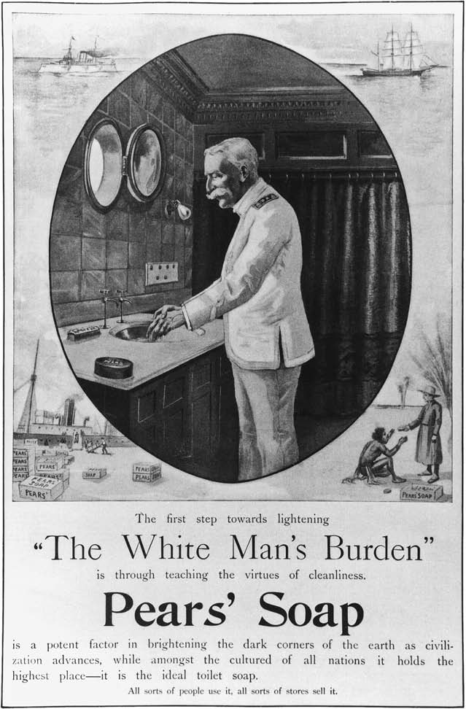
Racism was often a by-product of Social Darwinist theory. At the turn of the twentieth century, racism permeated many facets of popular life. This ad for Pears’ Soap caters to the racist attitudes held by many whites during this time.
Notes:
Racism was often a by-product of Social Darwinist theory. At the turn of the twentieth century, racism permeated many facets of popular life. This ad for Pears’ Soap caters to the racist attitudes held by many whites during this time.
Library of Congress/Colliers, October 4, 1899

Slide 13
Christianity Under Siege / Intellectual Skepticism
History – writers of the late 19th and early 20th century question the historical accuracy of the Bible, citing no genuine historical evidence
Others will go out to find the evidence
Science – Darwin and other scientists doubt the story of Creation, citing that the Earth is much older than the Bible
Morality
Liberal intellectuals question the cruelty and sacrifices mentioned in the Bible
Friedrich Nietzsche – felt Christianity glorified weakness, rather than strength
Movement towards secularism

Slide 14
Friedrich Nietzsche (1844-1900)
Philosophical critic of Enlightenment & rationalism
Hated all religions
“God is dead and we have killed him”
Proclaimed no single morality could be appropriate to all people
Awaited a heroic superman who would rule through the “will to power”

Slide 15
Friedrich Nietzsche
Questioned rational thinking, Christianity, democracy, nationalism, science and progress
In The Birth of Tragedy (1872), he argued the non-rational aspects of human nature are as noble as rational characteristics
Critical of racism and anti-Semitism
Sought the heroism he saw in the Greek Homeric age
Appealed to feelings and emotions in questioning rationalism

Slide 16
Conflict Between Church and State
Great Britain – churches opposed improvements in government schools because it raised the costs of church schools / Education Act of 1902 – provided state support for religious and non-religious schools
France – public schools expanded, religious teachings replaced by civic training and Napoleonic Concordat terminated separating church and state
Germany
Education secularized in 1870-1871 under Bismarck
“May Laws” of 1873 – require priests to be educated in German schools and pass state examinations
Bismarck’s Kulturkampf “cultural struggle” provokes Catholic resentment against the German state

Slide 17
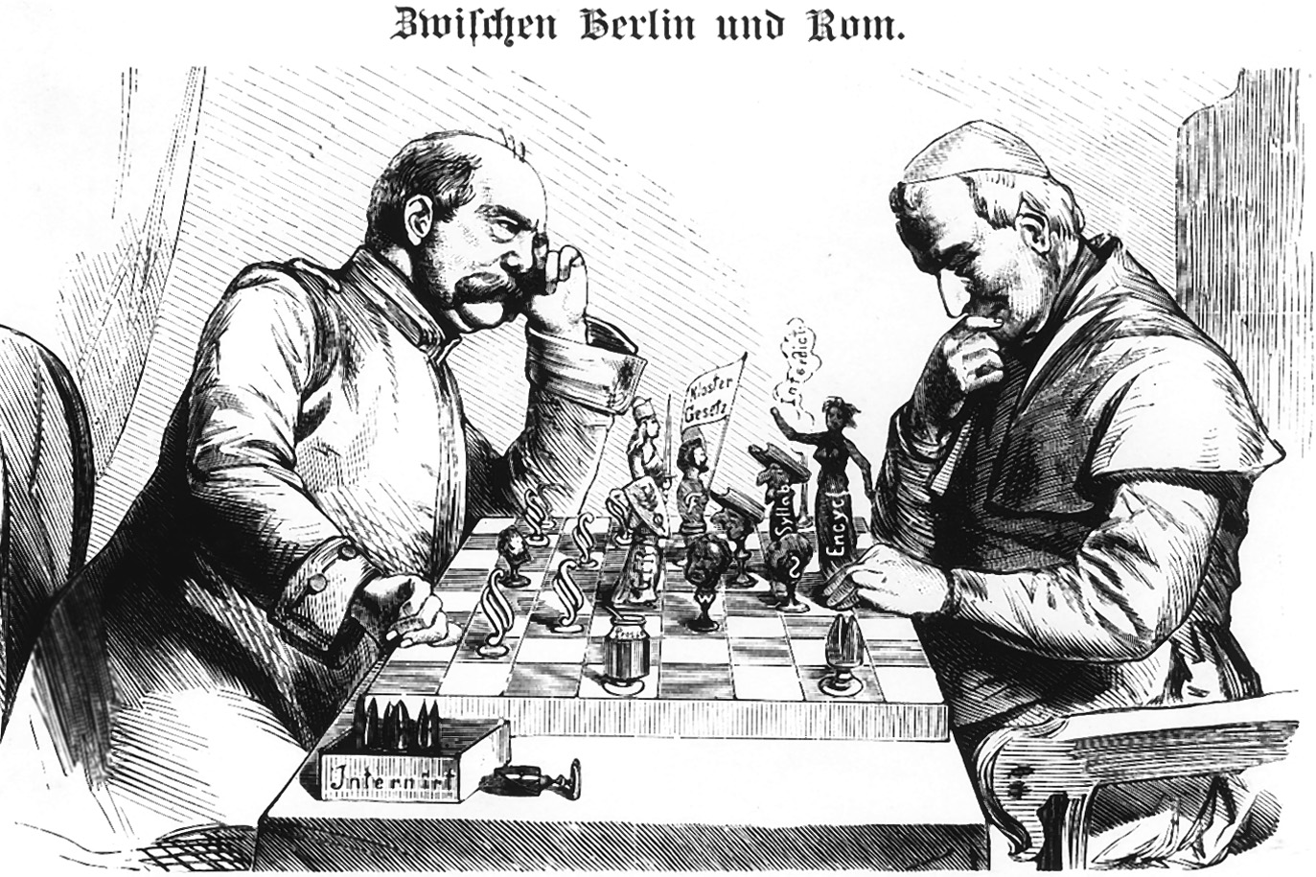
Conflict Between Church and State in Germany The conflict between the German imperial government and the German Roman Catholic Church was among the most intense church-state encounters of the late nineteenth century. Here the tumultuous event is somewhat trivialized as Bismarck and the Pope are portrayed attempting to checkmate each other.
Notes:
Conflict Between Church and State in Germany The conflict between the German imperial government and the German Roman Catholic Church was among the most intense church-state encounters of the late nineteenth century. Here the tumultuous event is somewhat trivialized as Bismarck and the Pope are portrayed attempting to checkmate each other.
Bildarchiv Preussischer Kulturbesitz

Slide 18
Catholicism
In Catholic countries, Church still provided alternative allegiance
Church was often AGAINST social and political change
1870 – Church proclaimed doctrine of papal infallibility – the pope’s proclamations have to be taken as absolute truth

Slide 19
Christian Socialism
Pope Leo XIII (p.1878-1903) – first to advocate for the rights of workers
Unintended consequence – rise of Christian Socialism
France, Germany, Belgium & Italy
Hoped to bring employers and workers to the Church
Organized cooperatives, charitable organizations & rural banks

