Slide 1
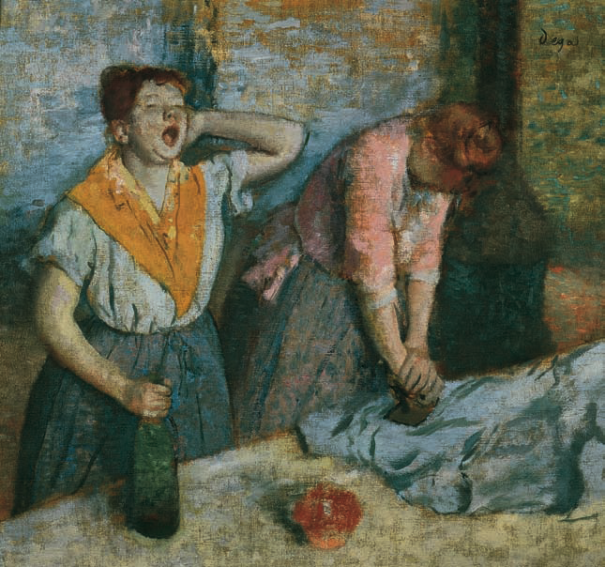
Chapter 23
The Building of European Supremacy:
Society and Politics to World War I

Slide 2
Jewish Citizenship
First half of 19th century, Jews in Western Europe began to gain equal citizenship
Still, many Jews could not own land and were subject to discriminatory taxes

Slide 3
Russian Jews
Government to the Jews
Limited book publications
Restricted areas where they could live
Banned them from state service
Excluded them from higher education
Pogroms – organized riots against Jewish neighborhoods, supported by the government

Slide 4
Opportunities for Jews
Western Europe – very open to Jews at all levels; (government, education, intermarriage with Christians)
Many Jews from Eastern Europe migrate to Western Europe or the United States
Anti-Semitism – discrimination against Jews, increases in Western Europe during later stages of 19th century, especially in France and Germany

Slide 5
Trade Unionism
Unions allowed in Europe in late 19th century
Unions looked for the improvement in wages and working conditions
Unions often engaged in long strikes
Despite growth of unions, most of Europe’s labor force never unionized

Slide 6
Political Parties
Universal male suffrage brings organized political parties
Political parties with its workers, newspapers, offices, social life, and discipline mobilize new voters
Socialist parties were divided on whether to accept social reform or start a revolution

Slide 7
The First International
British and French trade unionists form the First International, made up of socialists, anarchists and Polish nationalists
Although short-lived, its updates on labor groups and conditions led to Marxism becoming the most important social strand of socialism

Slide 8
Social Reform in Great Britain
British socialism – non-Marxist – most influential group the Fabian Society – favored gradual, peaceful approach to social reform
Under Liberal Chancellor David Lloyd George, Britain regulates trade, provides unemployment benefits and health care
Conservative House of Lords upset with the spending of the Liberal House of Commons in the Parliament

Slide 9
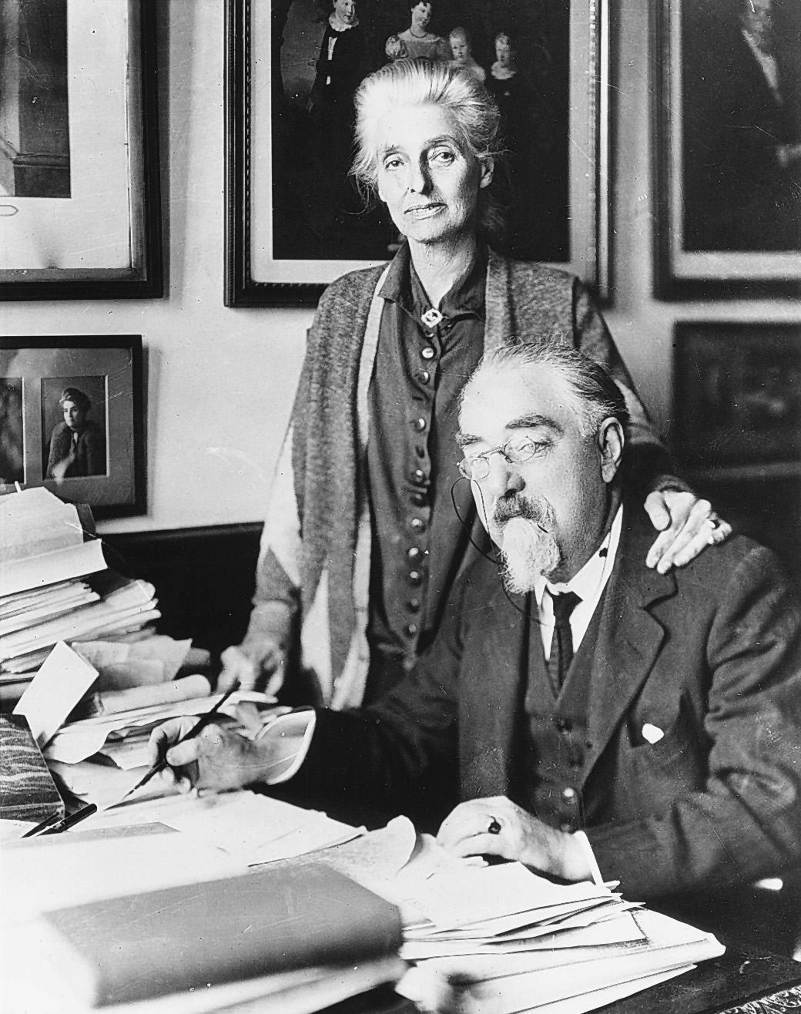
Beatrice and Sidney Webb. These most influential British Fabian Socialists, shown in a photograph from the late 1920s, wrote many books on governmental and economic matters, served on special parliamentary commissions, and agitated for the enactment of socialist policies.
CORBIS/Bettmann
Notes:
Beatrice and Sidney Webb. These most influential British Fabian Socialists, shown in a photograph from the late 1920s, wrote many books on governmental and economic matters, served on special parliamentary commissions, and agitated for the enactment of socialist policies.
CORBIS/Bettmann

Slide 10
French Opportunism Rejected
Opportunism – participation by socialists in the cabinets is rejected by Congress
French socialists form their own party
French workers often voted Socialist, but avoided political action
Non-socialist labor unions looked to strikes as their main labor tactic

Slide 11
Social Democrats and Revisionism in Germany
Bismarck represses German Social Democratic Party (SPD)
Anti-socialist laws passed by Reichstag actually strengthen the numbers of the (SPD)
Passes programs such as accident insurance, disability and old age pensions as a conservative alternative to socialist policies
The Erfurt Program – supported Marxist ideas of the collapse of capitalism, but wanted to pursue goals through legislative action, not revolution
Revisionism – German socialists’ ideas of achieving humane social equality without having a revolution founded by Eduard Bernstein
Critics of Revisionism felt that evolution towards socialism would not work in militaristic, authoritative Germany

Slide 12
Industrial Growth in Russia
Count Sergei Witte – first Russian minister of communications and later finance minister, wanted to modernize Russian economy through:
Economic development
Protective tariffs
High taxes
Russian currency on gold standard
Steel, iron, and textile industries expand as Trans-Siberian Railroad is completed (1903)
Social unrest – growth of industry does not improve lives of the peasants, many of whom have to work on the land of prosperous farmers known as kulaks
Liberal party formed by the local councils (zemstvos) wanted a constitutional monarchy to further civil liberties and social progress

Slide 13
Vladimir Lenin – future leader of the communist revolution
Led Social Democrats who rejected the German ideas of gradual socialism and called for a revolution
Social Democratic Party split into two:
Lenin’s faction, the majority or Bolsheviks
The moderate faction, the minority or the Mensheviks
Wanted to unite workers and peasants to overthrow the tsar (idea came about in 1905, but revolution didn’t occur until 1917)

Slide 14
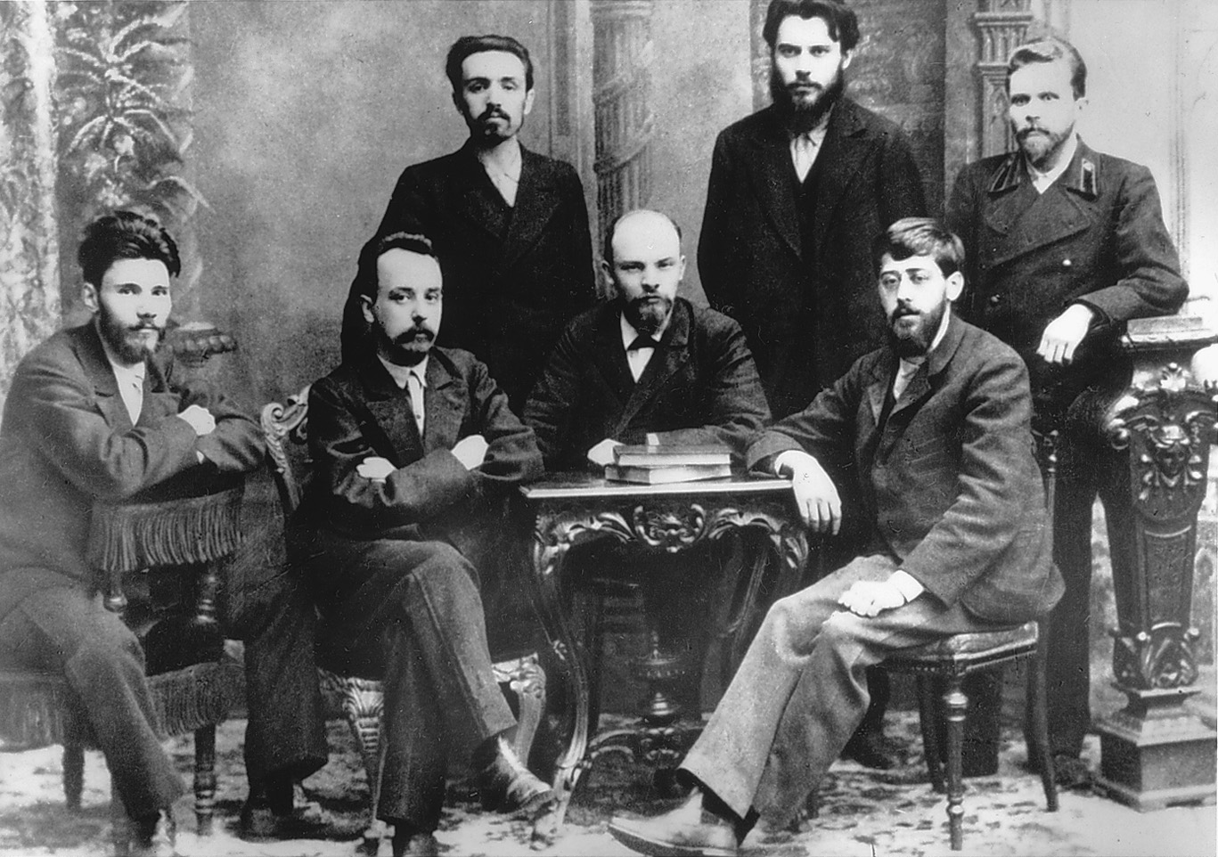
Notes:
In this photograph taken in 1895, Lenin sits at the table among a group of other young Russian radicals from Saint Petersburg.
CORBIS/Bettmann

Slide 15
The Revolution of 1905
Bloody Sunday – tsar’s troops violently put down a protest, leading to ordinary Russians no longer trusting the tsar
Worker groups called the soviets – not the tsar – basically control city of St. Petersburg
Nicholas II issues October Manifesto promising a constitutional government
Representative body, the Duma, put into place in 1907 – conservative in nature, basically kept the power of the tsar in place
Stolypin and Rasputin
P.A. Stolypin – replaced Witte as finance minister
Represses socialist rebellion, including execution of rebellious peasants
Improves agricultural production by encouraging individual ownership
Assassinated by a Social Revolutionary
Grigory Efimovich Rasputin – replaced Stolypin because supposedly his wife could heal the tsar’s hemophiliac son; uncouth and strange, tsar’s power is undermined after 1911

Slide 16
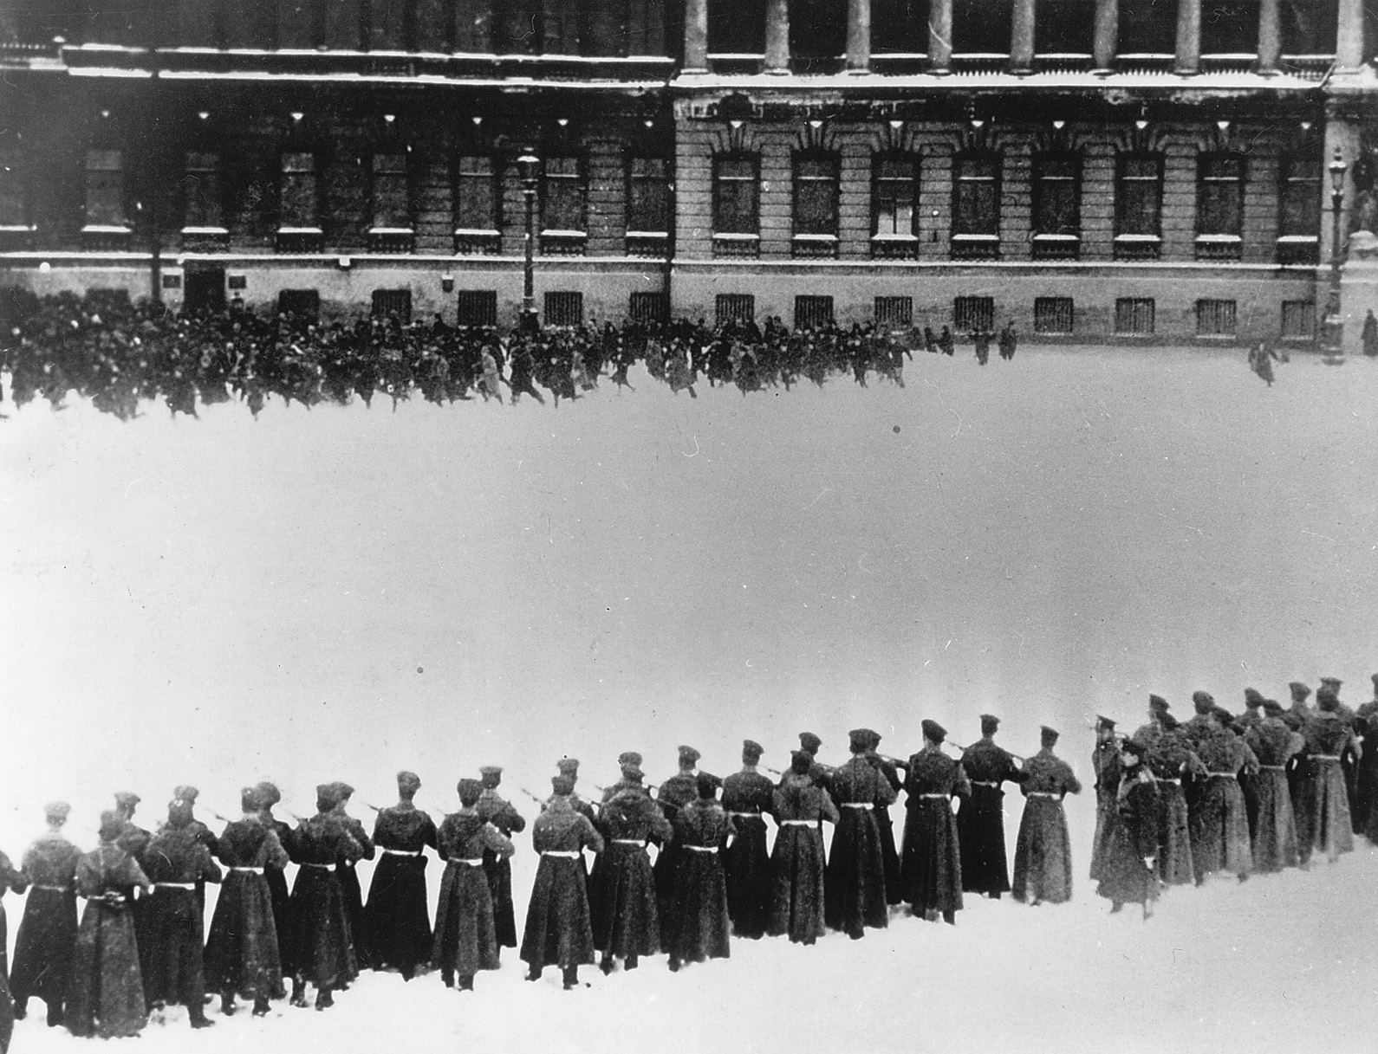
Notes:
Bloody Sunday, St. Petersburg 1905 On Bloody Sunday, January 22, 1905, troops of Tsar Nicholas II fired on a peaceful procession of workers at the Winter Palace who sought to present a petition for better working and living conditions. The scene portrayed here depicts one of the enduring images of events leading to the subsequent Russian Revolutions of 1905 and 1917. It figured in at least two movies: the 1925 anti-tsarist Soviet silent film called “The Ninth of January,” and “Nicholas and Alexandra,” the lavish 1971 movie that was sympathetic to the tsar and blamed Bloody Sunday on frightened and incompetent officials. While Nicholas had not ordered the troops to fire and was not even in St. Petersburg on Bloody Sunday, the event all but destroyed any chance of reconciliation between the tsarist government and the Russian working class.
Bildarchiv Preussischer Kulturbesitz

