Slide 1
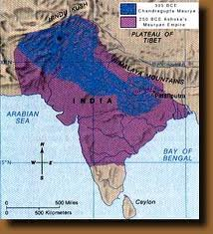
The Gupta Empire

Slide 2
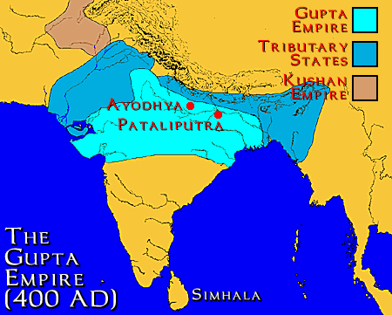
The Gupta Empire
After 500 years, a strong leader again arose in the northern state of Magadha
His name, Chandra Gupta (no relation to the first)
Second Empire → Gupta Empire (saw a pinnacle of the Indian civilization, especially Hindu culture)

Slide 3
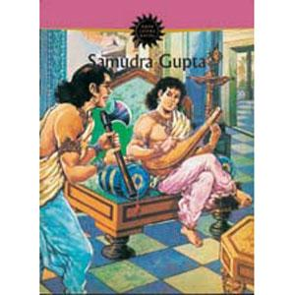
Chandra Gupta Builds an Empire
After marrying the daughter of the old, royal family, Chandra took the title of “Great King of Kings”
Samudra, Chandra’s son, took power next
Lover of poetry and music, also had a belligerent side
He expanded the empire with 40 years of war and conquest

Slide 4
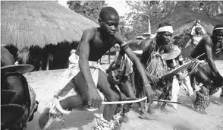
Daily Life in India
The Gupta Era is the first period about which historians have a lot of information concerning daily life in India
Most lived in small villages, most of which were villagers
Most families were patriarchal= headed by the eldest male
Droughts were a huge problem, men had to give a days worth of work on the wells
Southern India was different, matriarchal= mother was the head of the family
Property and the throne followed through the mother’s line

Slide 5
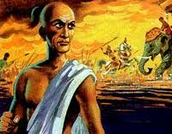
Height of the Gupta Empire
Chandra Gupta II (ruled for 40 years)
Conquered the enemy, Shakas, to the west
Increased territory
Trade increased between India and the Mediterranean world
Increased diplomacy and marriage alliances
Achievements in: literature, religious thought, science and mathematics
End: Broke into small pieces and then was overrun by the Huns and other Central Asian nomads

Slide 6
Gupta Empire
https://www.youtube.com/watch?v=5upeOZHzSyw

Slide 7
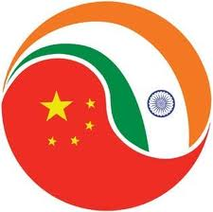
Trade Spreads Indian Religions and Culture
Main Idea: Indian religions, culture, and science evolved and spread to other regions through trade
Why it matters now? The influence of Indian culture and religions is very evident throughout Southeast Asia today

Slide 8
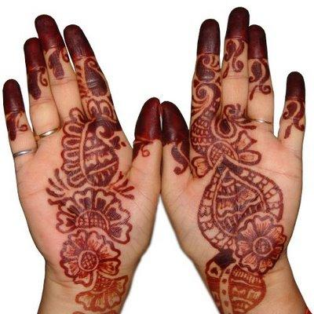
Setting the Stage:
500 years between Mauryan and Gupta Empire was a time of upheaval, invaders surged into India, bringing new ideas and customs
In response, the Indian culture changed
Cultural Diffusion

Slide 9
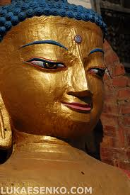
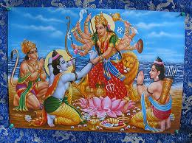
Changes in Religious Thought
In 250 BCE, Hinduism and Buddhism were India’s two faiths
Hinduism= mix of polytheistic religion that blended Aryan and pre-Aryan beliefs
Buddhism= desires cause suffering, Eightfold Path
Over the centuries, both religions had been increasingly removed from the people
Hinduism was dominated by priests, Buddhism was hard to follow

Slide 10
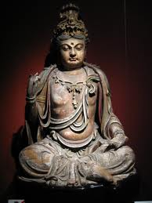
A More Popular Form of Buddhism
After the Buddha died, many different interpretations of Buddhism developed
The Buddha did not want to be worshiped, but after his death, many began worshiping him like a god
Some Buddhists believed that many people could become Buddhas (these potential Buddhas were called “bodhisattvas” who choose to give up nirvana and work to save humanity through good works and self sacrifice)
Buddhism became a mass religion that offered salvation to all and allowed popular worship

Slide 11
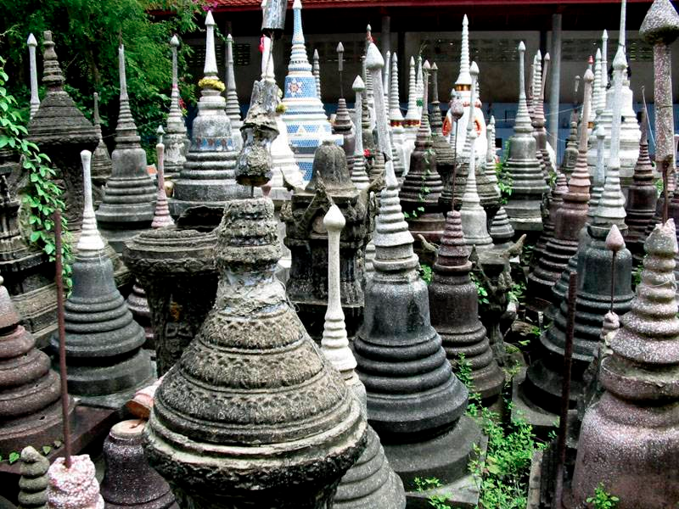
A More Popular Form of Buddhism
Mahayana Buddhism= accept new popular belief of Buddhism (majority)
Theraveda Buddhism= those Buddhists who held to Buddha’s stricter, original teachings (minority)
New trends of Buddhism, inspired Indian art
Huge statues of Buddha for people to worship
Stupas= mounded stone structures built over holy relics
Buddhists walked the path circling the stupas as part of their mediation
Cave temples of solid rock

Slide 12
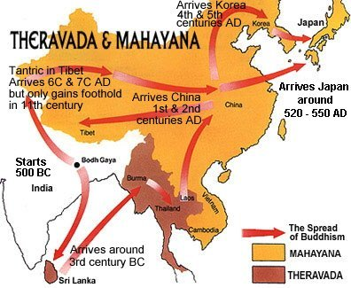

Slide 13
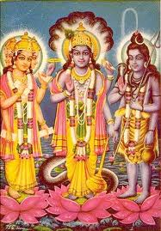
A Hindu Rebirth
Hinduism had developed a complex set of sacrifices that could only be performed by priests
Through its exposure to other cultures, Hinduism changed too
A trend towards monotheism was growing
Many people began to believe that there was only one divine force in the universe
3 most important gods were: Brahma (creator of the world), Shiva (destroyer of the world), and Vishnu (preserver of the world)

Slide 14
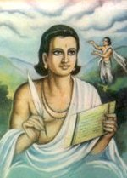
Flowering of the Indian Culture
Literature and the Performing Art
Kalidasa= one of India’s greatest writers (Shakuntala- story of a beautiful girl that falls in loved and marries a middle aged king)
Writing Academies
Drama also became very popular (traveling performances)
Dance

Slide 15
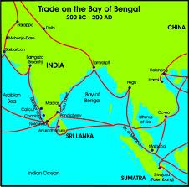
Astronomy, Mathematics and Medicine
Advance of trade spurred the advance of science:
From Greek invaders, Indians adapted Western methods of keeping time
Calendar based on the cycles of the sun rather than the moon, seven-day week
Almost 1,000 years before Columbus, Indian astronomers proved that the earth was round by observing a lunar eclipse
Modern numerals, the zero, and the decimal system, were invented in India
Classified more than 1,000 diseases, described 500 plants
Hindu physicians knew how to perform surgery- including plastic surgery

Slide 16
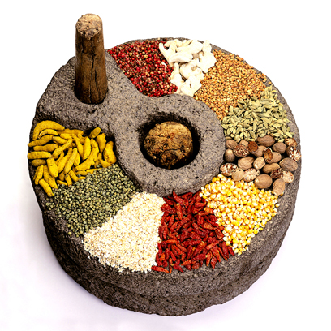
The Spread of Indian Trade
Rich in precious resources
Spices, diamonds, sapphires, gold, pearls, and beautiful woods (ebony, teak and sandalwood)
Trade included Africa and Sumerian

Slide 17
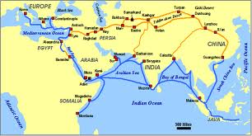
Overland Trade, East and West
Those groups who invaded India at the end of the Mauryan rule helped expand India’s trade to new regions
Silk Roads= traders used them to bring silk from China to Western Asia and on to Rome
Once Indians learned the Silk Roads, they realized that they could make great profits by acting as the middleman (set up stations along the trade routes)

Slide 18
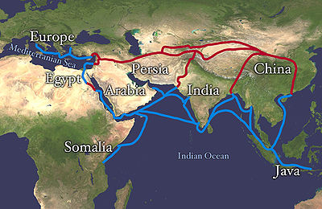
Sea Trade, East and West
Sea Trade also increased
Spices were traded between India and Rome
India imported African ivory and gold and exported cotton cloth
Sea trade with China increased (imported cotton cloth, monkeys, parrots, and elephants)

Slide 19
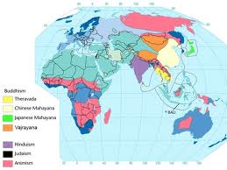
Effects of Indian Trade
Increased trading led to a rise in banking
Bankers made a lot of money off trading merchants
Indian culture spread throughout Southeast Asia
Hinduism spread to Nepal, Sri Lanka, Borneo,
Buddhism spread because of traveling monks

