Slide 1
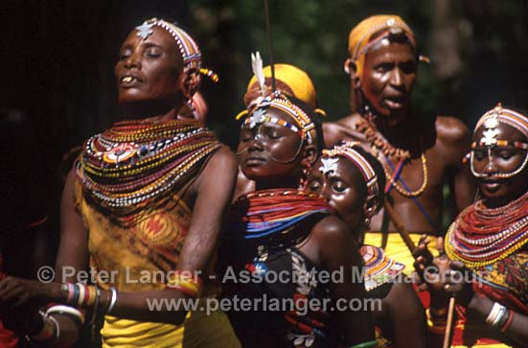
Animism
Animism is the belief that all living and nonliving things in nature have a spirit.
Animism was the belief system of many early civilizations.
Animism in early civilizations was often combined with ancestor worship.

Slide 2

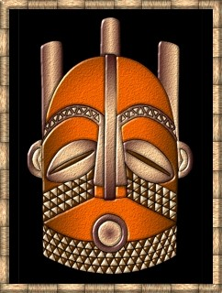
Animism dates back to earliest humans and still exists. It can be practiced by anyone who believes in spirituality, but does not proscribe to an organized religion. Animist gods and beliefs often explain natural earthly things. The presence of holy men or women, visions, trances, dancing, sacred items and places are often characteristic of animist societies. Animism exists in traditional African, Asian, American and Aboriginal cultures.

Slide 3
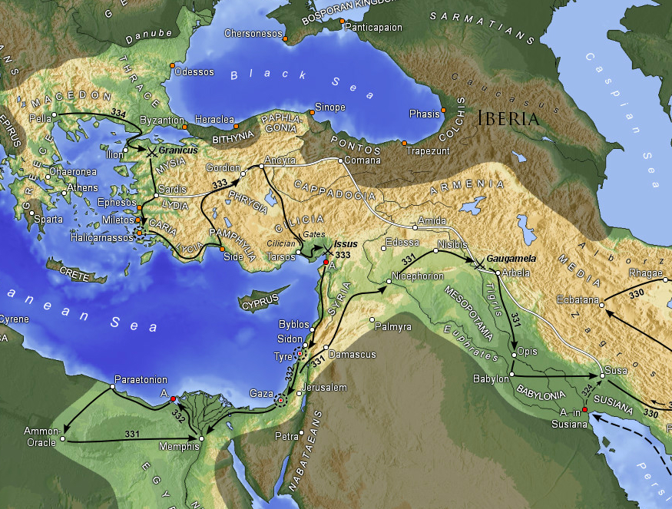
HELLENISM
As a result of Alexander’s conquests, Greek language and culture spread throughout the Eastern Mediterranean.

Slide 4
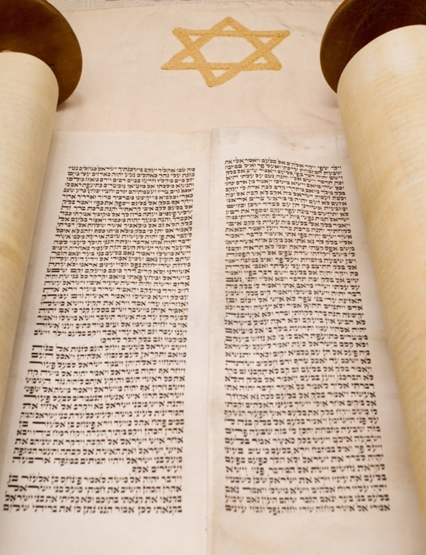

LLX
The Septuagint
The Hebrew Bible was translated into Greek during the 3rd century B.C.E.

Slide 5
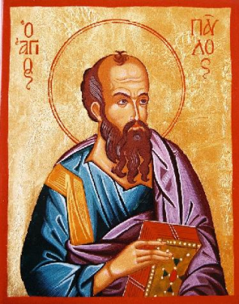
Hellenistic Judaism
Tarsus
  The Apostle Paul was born here and raised as a Hellenized Jew.
Although native Judeans rebelled against Alexander’s heirs, Jews of the Diaspora embraced Hellenism.

Slide 6
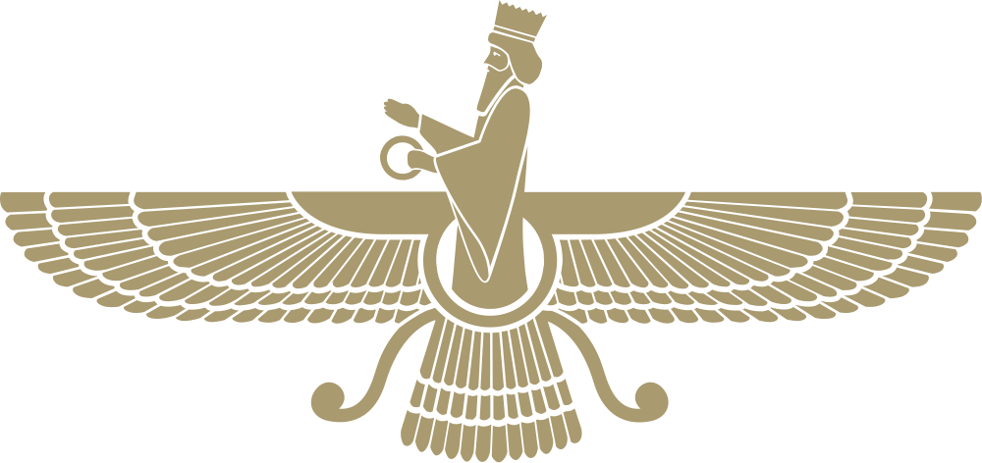
Zoroastrianism
The Religion of Ancient Persia

Slide 7
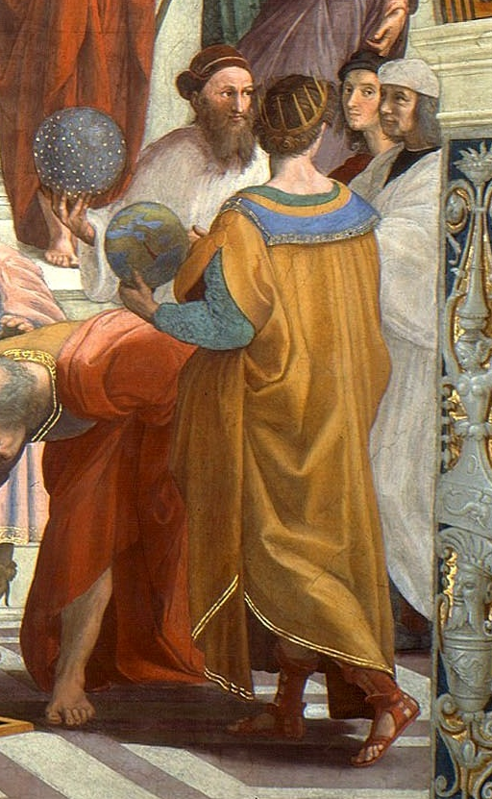
Zoroaster
(aka, Zarathustra)
Founder
&
Prophet
of Zoroastrianism
Zoroaster holding a star-studded globe in Raphael’s painting, The School of Athens

Slide 8
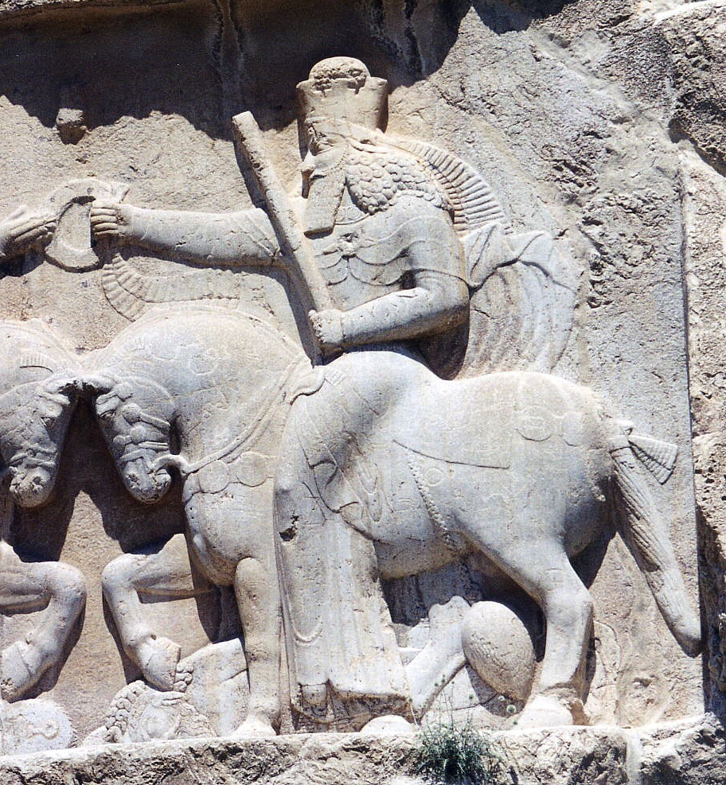
Ahura Mazda
WISDOM
LIGHT
Photo Credit: Ginolerhino

Slide 9
Zoroastrianism
Holy scripture- ‘Gatha’ & ‘Avesta’
Temples are called Atash Behram, aka Fire Temple
648 BCE Achaemendid Empire or First Persian Empire (Cyrus the Great) established Zoroastrianism as the state religion

Slide 10

The Pillars of Zoroastrianism
Thoughts
Words
Deeds

Slide 11
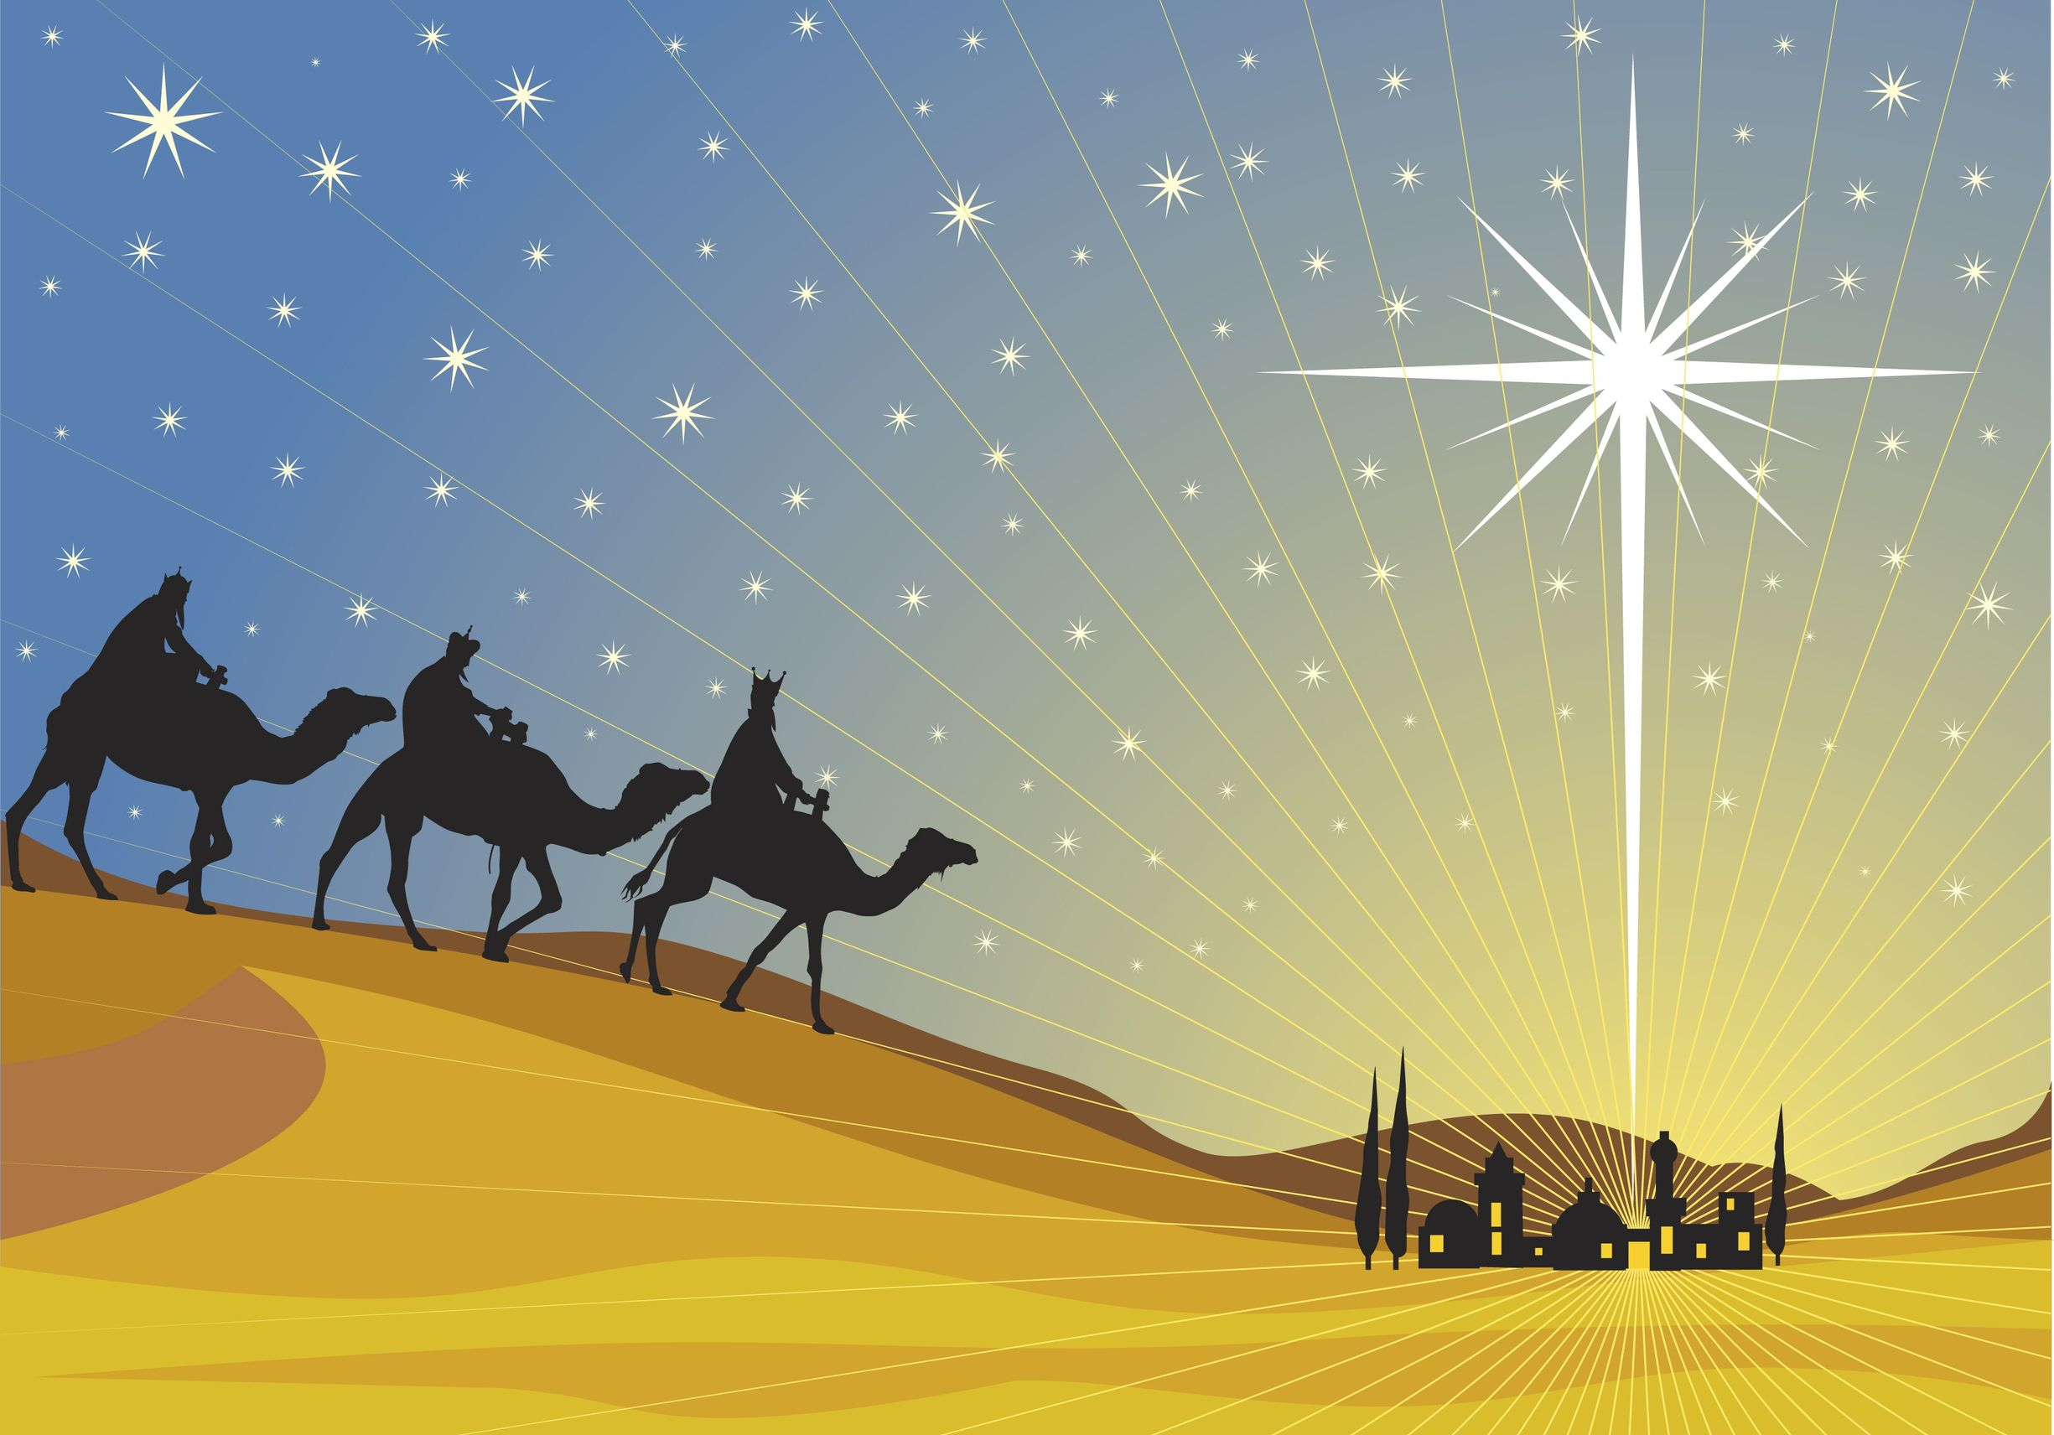
Zoroastrians?
Magi?
Naci Yavuz

Slide 12
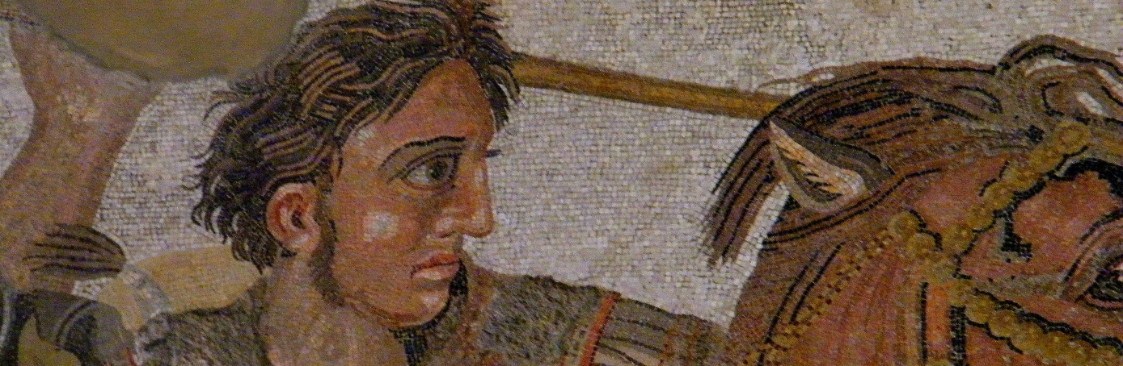
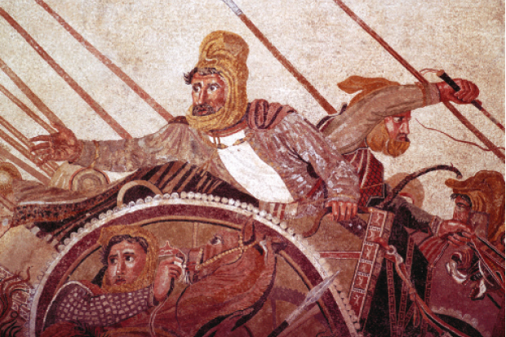
Alexander the Great Conquers Persia
330 BCE defeats Darius III

Slide 13
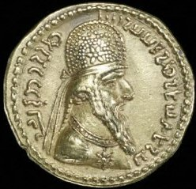
Sassarian Dynasty
208 CE Ardashir conquers Persia
Zoroastrianism Comes back to power
651 Persia is conquered by the Muslims
  Seen as infidels by Muslims
  By 900 CE Zoroastrinan believers flee to Mumbai India, Parsi

Slide 14
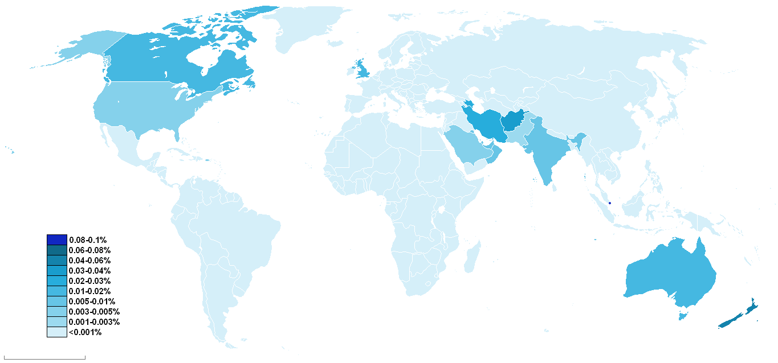
Zoroastrianism Today
Over 125,000 Zoroastrians are spread across the globe.

Slide 15
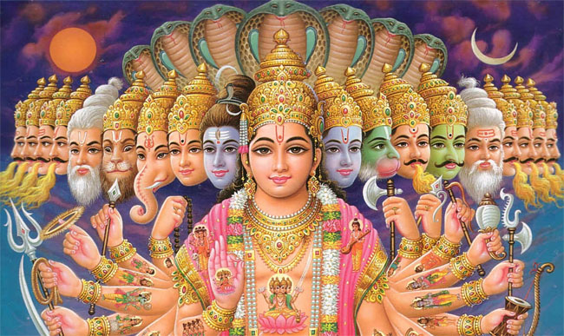
Introduction to Hinduism
“There is only one God, but endless are his aspects and endless are his names”

Slide 16

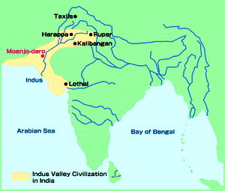
EARLY INDIA
Hinduism began in the Indus Valley approximately 2500 BCE

Slide 17
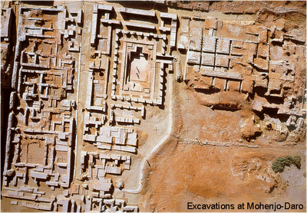
EARLY INDIA
Fertile land due to river flooding from monsoon weather patterns (wet monsoon in summer, dry monsoon in winter)
Little is known – can’t interpret their writing.
Some evidence of large well-planned cities with public drainage. Agriculture and trade patterns were likely.

Slide 18
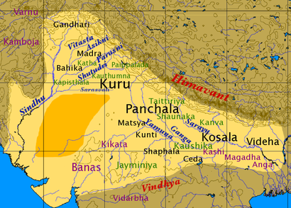

EARLY INDIA – Vedic Period
Aryan people invaded India from the north
First period in Indian history that we can read the language
Collections of villages but not much evidence of grand cities
Hinduism developed out of this period

Slide 19
What is Hinduism?
One of the oldest religions of humanity
The religion of the Indian people
Gave birth to Buddhism, Jainism, Sikhism
Tolerance and diversity: "Truth is one, paths are many"
Many deities but a single, impersonal Ultimate Reality
A philosophy and a way of life – focused both on this world and beyond

Slide 20
How did Hinduism begin?
No particular founder
Indus River Valley Civilization >5000 years ago
Aryans enter 4000 - 3500 years ago
Vedic Tradition 3500 – 2500 years ago:
  rituals and many gods (polytheism)
  sacred texts (Vedas)
  social stratification (caste system)
Upanishads (metaphysical philosophy) 2800 – 2400 years ago
Vedic Tradition develops into Hinduism

Slide 21
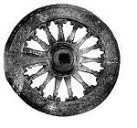
Goal of Hinduism
Achieve Moksha: “release or liberation”
United forever with the divine
Infinite bliss and awareness

Slide 22
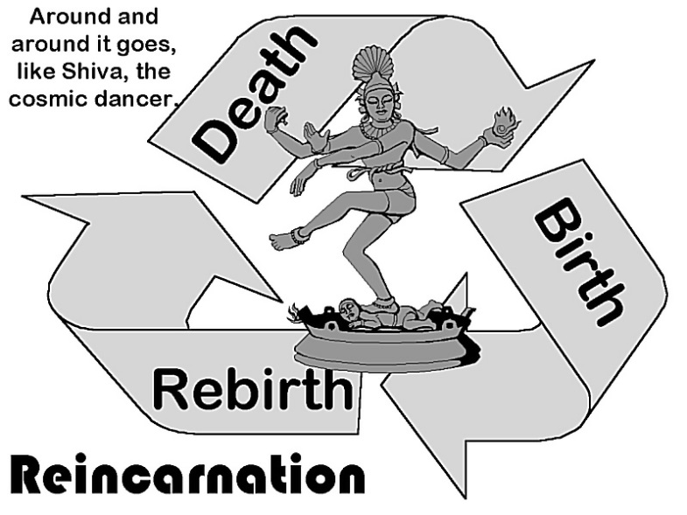

Reincarnation
Samsara is the wheel of rebirth which means the soul is reborn from one life form to another.
People may be reincarnated at a higher or lower level of existence depending on their karma from their present life.
People may be reborn as plants or animals or they may be elevated to a higher caste as a human.
Death is not final for Hindus as they expect to be reborn many times.

Slide 23
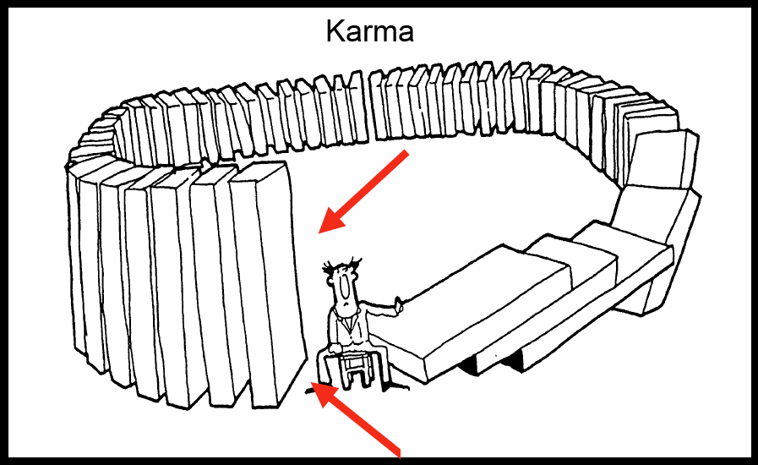
Karma & Dharma
Karma: “action” or “deeds”
Every action produces a justified effect based on its moral worthiness.
Karma determines all the particular circumstances and Situations of one’s life.
Dharma: ethical duty based on the divine order of reality. The word is the closest equivalent to “religion.”

Slide 24
Four Stages of Life
Stage One: Student stage
Stage Two: Householder
Stage Three: Forest-dweller --after the birth of
first grandchild
Stage Four: Sannyasin - wondering ascetic
-a person who is very self-disciplined

Slide 25
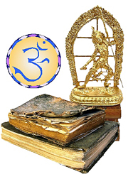
What are the Sacred Texts?
Shruti (“heard”) – oldest, most authoritative:
  Four Vedas (“truth”) – myths, rituals, chants
  Upanishads - metaphysical speculation
  Plus other texts
Smriti (“remembered”) – the Great Indian Epics:
  Ramayana
  Mahabharata (includes Bhagavad-Gita)
  Plus others

Slide 26
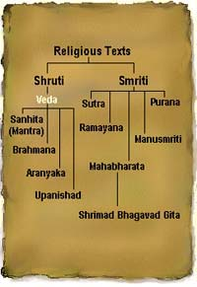
The Vedas
1200 BCE-600 BCE.
written in SANSKRIT.
Hindu core of
beliefs:
  hymns and poems.
  religious prayers.
  magical spells.
  lists of the gods
  and goddesses.
Rig Veda → oldest work.

Slide 27
Varna (Social Hierarchy)
Brahmins
Kshatriyas
Vaishyas
Shudras
Pariahs (Harijan) ≈ Untouchables

Slide 28
Caste System
Four major castes
Brahmin : priests
Kshatriya: warriors and administrators
Vaistrya: farmers, merchants, teachers, artisans
Sudras: servants, laborers

Slide 29
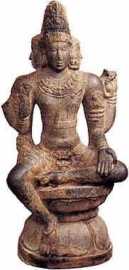
The Caste System
Brahmins
WHO IS…
Kshatriyas
The mouth?
The arms?
The legs?
The feet?
Vaishyas
Shudras

Slide 30
Who is a Hindu?
Hindus can be polytheists, monotheists, pantheists, dualists, monists, agnostics or atheists. How do these differ?
  “Of all the world’s great religions, Hinduism is the most difficult to define. It did not have any one founder….It has many scriptures which are authoritative but none that is exclusively so.” Bruce J. Nichols, “Hinduism,” in The World’s Religions, Norman Anderson, ed., ISBN 0851113141, p. 136.)
  The only general obligation is to abide by the rules of their caste, so as to gain a better reincarnation. (Noss, p. 72-73)
30
Notes:
Approach a Hindu using diagnostic questions, like a doctor treating a patient for the first time.
“Do you believe in god?” “What god do you worship?”
“Have you ever done something wrong?” “How do you deal with that?” “Christians believe that….”
30

Slide 31
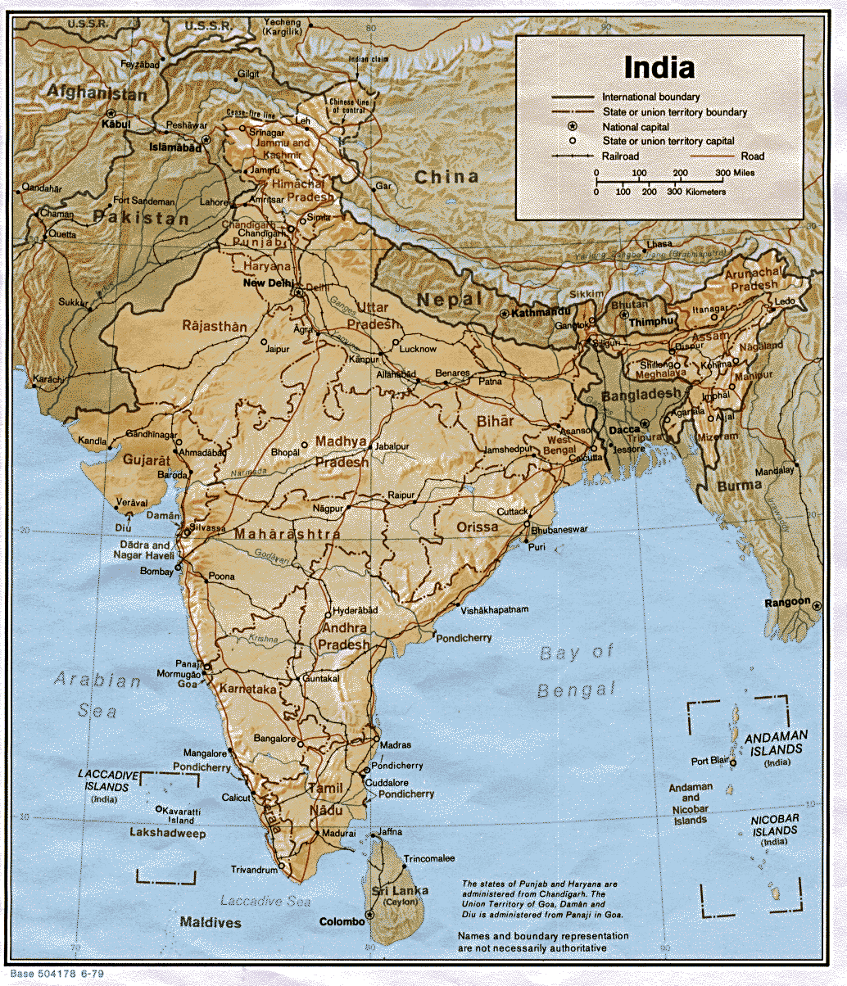
The vast majority of Hindus Today live in India and Nepal

Slide 32
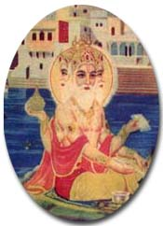
Brahman: essence of reality
He is not ultimate reality because he can be visualized.
Brahma’s life span = each day is 1000 times the whole of human history.
The world will end with the appearance of Vishnu is about 4000 years from now.

Slide 33
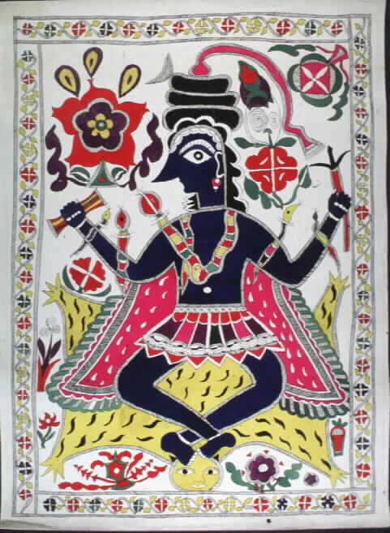
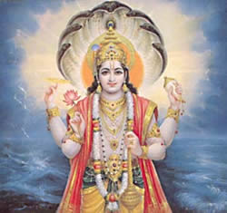
THE TWO MOST POPULAR GODS
SHIVA
VISHNU

Slide 34
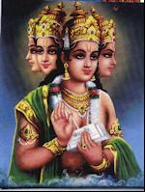
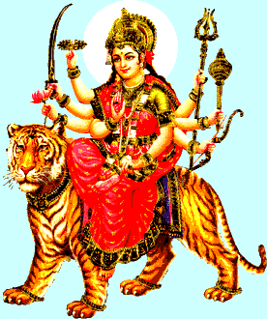
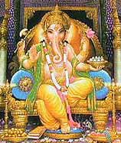
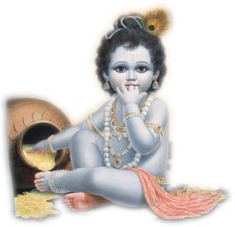
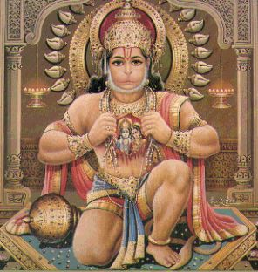
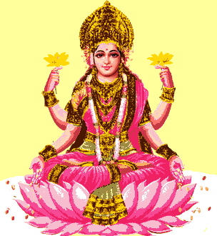
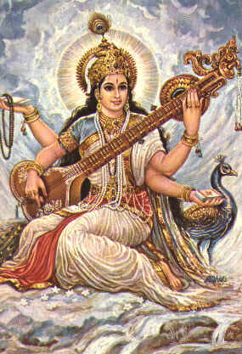
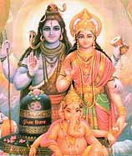
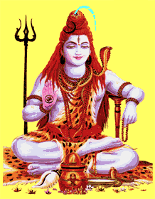
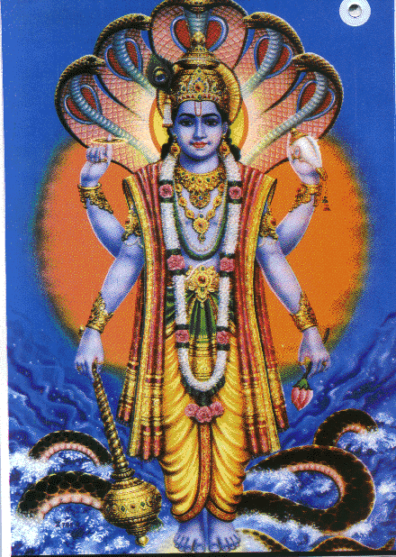
All these deities are but
Manifest forms (attributes
and functions) of the
impersonal Brahman

Slide 35
Festivals and Holy Days
no set day of the week is holy-each days has its possibilities
Religious festivals may be solar or lunar-lunar is preferred
In order to keep festivals consistent, an additional lunar month is added to the calendar about every three years.
Some numbered days of the month are more important than others. There are 125 special days in the Hindu year.

Slide 36
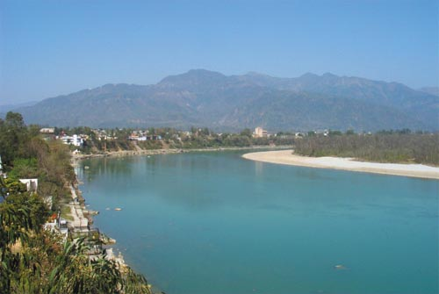
The Ganges River
Falling from
Its source of
Vishnu’s feet
onto Shiva’s
head and out
from his hair,
the water of
the Ganges is
sacred enough
to purify all
sins.

Slide 37
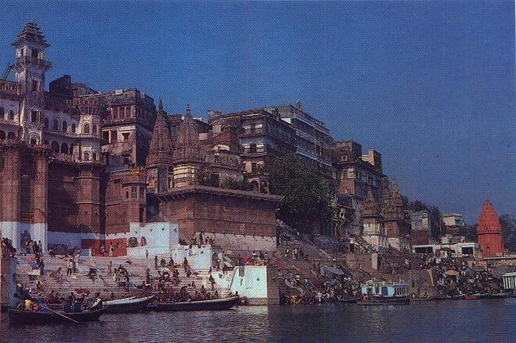
Banaras - Hindu’s Holy City
Pilgrims come from all over to bathe in the Ganges.
Countless Hindus come to Banaras to die.
It has 1500 temples, most of them devoted to Shiva.
It is a gathering place for the religiously learned and their disciples.

Slide 38
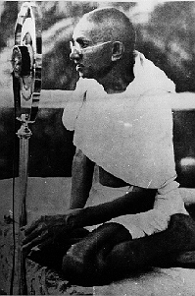
Gandhi: the Father of India
For Gandhi, social concern was deeply rooted in his conviction of the
Sacredness of life.
Gandhi believed that human beings should strive to live as simply as possible since overindulgence often meant that others may have to do without their basic needs.
Gandhi was assassinated by a Hindu fanatic on January 30, l948 as India was gaining its independence.
Notes:
overindulgen

Slide 39
Karma and Reincarnation
Reincarnation is the belief that the soul repeatedly goes through a cycle of being born into a body, dying, and being reborn again in a new body.
Karma, a force that determines the quality of each life, depending on how well one behaved in a past life.
Hinduism says we create karma by our actions on earth. If you live a good life, you create good karma. If you live a bad life, you create bad karma.
Notes:
39

Slide 40
Moksha
Each time a Hindu soul is born into a better life, it has the opportunity to improve itself further, and get closer to ultimate liberation.
This liberation is called Moksha.
One attains Moksha when one has "overcome ignorance", and no longer desires anything at all.
The ones who reach this state no longer struggle with the cycle of life and death.
The way to get to Moksha is to not create any karma.
Notes:
40

