Slide 1
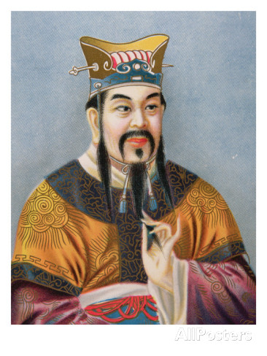
Confucianism
Less of a religion
More of a philosophy and way of life

Slide 2
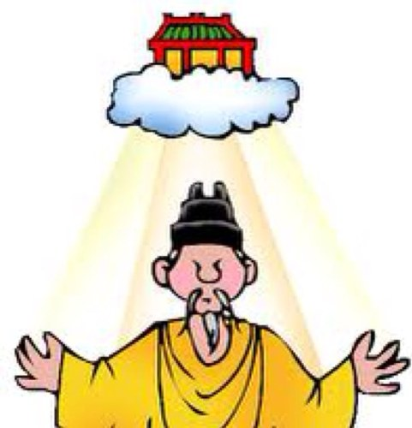
Origins and Development
Based on the teachings of Confucius (551-479 B.C.E.)
China was in a state of civil war
Mandate of Heaven
Rulers held power with the support of heavenly spirits
If the ruler governed poorly, heaven withdrew its support and the ruler lost power

Slide 3
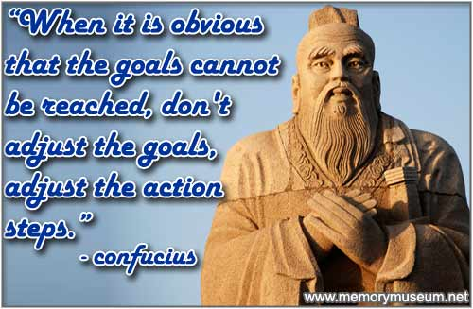
Origins and Development (Continued)
Confucius believed that a revival of traditional Chinese culture would help restore order in society and promote harmony between earth and Heaven.
His Main Goal: Influence government
He failed to win support in
his lifetime but in death
his ideas gained favor

Slide 4
The Beliefs of Confucianism
Ancient Chinese worshiped many gods and spirits, including their ancestors
Confucius focused on human society and life on earth
“If we are not yet able to understand life and to serve humanity, how can we understand death and serve spirits?”

Slide 5
The Beliefs of Confucianism (Continued)
Confucius believed building a better society would bring humans closer to heaven.
Follow ethical guidelines
Live a life of virtue
Treat others with respect and kindness
“What you do not want done to yourself, do not do to others”

Slide 6
Five Basic Relationships in Society
1.Parent and child***
2.Husband and wife
3.Older sibling and younger sibling
4.Friend and Friend
5. Ruler and subject
Filial piety- Respect of children for their parents
Critical to the social order
People should respect and obey their elders
Elders should set a good example
Kind, honest, wise, and faithful

Slide 7
Respect for all People
Confucius stood up for the rights of the common people
Accepted students from all walks of life
Rich and poor
He called for universal education to benefit all society

Slide 8
The Spread and Influence of Confucianism
His teachings were collected into a book called the Analects
Adopted as the state ideology
Set of basic ideas, beliefs, and values that form the basis of a social, economic, or political philosophy or program
Became the basis of the state civil service exam
Some even worshiped Confucius as a god
Confucianism became a state religion in China
Confucianism also spread to Korea, Japan, and Southeast Asia

Slide 9
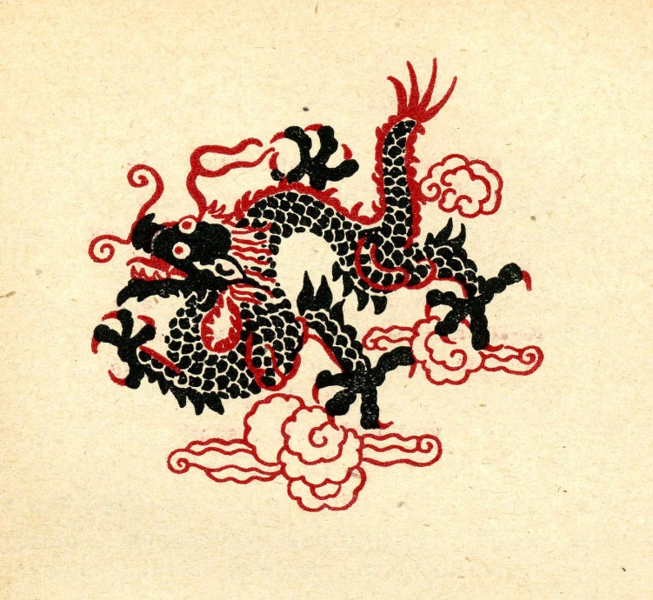
Daoism
Living in harmony with nature The natural order is more important than the social order A universal force guides all things Human beings should live simply

Slide 10
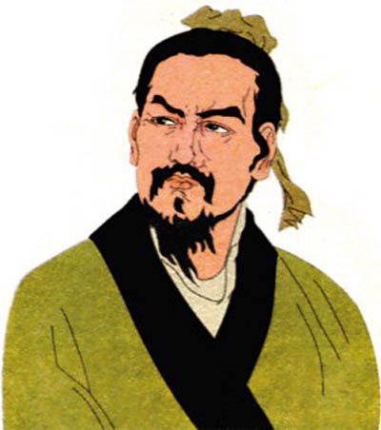
Legalism
A highly efficient and powerful government is the key to social order Punishments are useful to maintain social order Thinkers and their ideas should be strictly controlled by the government

Slide 11
Yin and Yang
Two opposing forces believed to be present in all nature
For harmony, they must be in balance
a. Yin-earth, female, passive
b. Yang-heaven, male, active

