Slide 1
Confucius Says

Slide 2
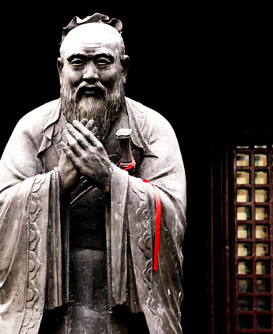
Confucius

Slide 3


Slide 4


Slide 5
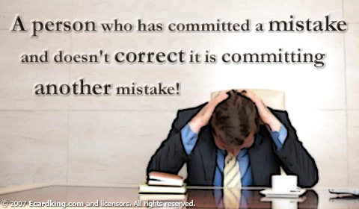

Slide 6


Slide 7


