Slide 1
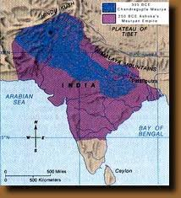
The First Empires of India
Mauryas
Asoka
Buddhism

Slide 2
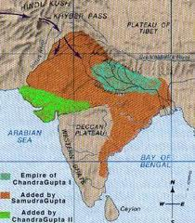
Main Idea: The Mauryas and the Guptas established Indian empires, but neither unified India permanently
Why it matters now? The diversity of peoples, cultures, beliefs, and languages in India continues to pose challenges to Indian unity today

Slide 3
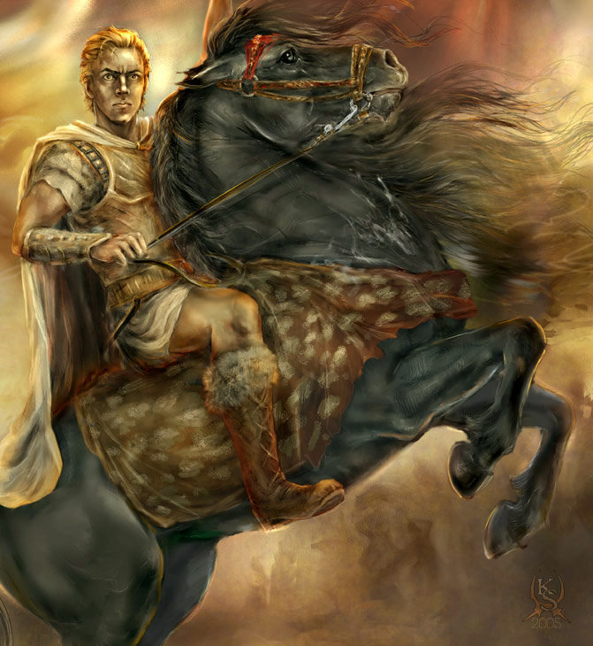
Setting the Stage
1. By 600 BCE, almost 1000 years after the Aryan migrations, many small kingdoms were scattered throughout India
2. In 326 BCE, Alexander the Great brought the Indus Valley under Greek control
3. After Alexander left India, a great Indian military leader, Chandragupta Maurya seized power for himself

Slide 4
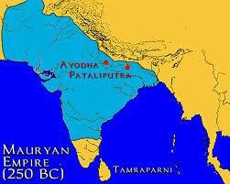
Chandragupta Maurya Builds an Empire
Most likely born into the kingdom of Magadha (by the Ganges River)
The kingdom had been ruled for centuries by the Nanda family
Chandragupta gathered an army and killed the king and then claimed the throne
This begun the Mauryan Empire

Slide 5
Mauryan Empire
https://www.youtube.com/watch?v=Bu5M_ifW-FY

Slide 6
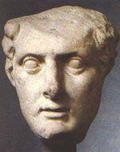
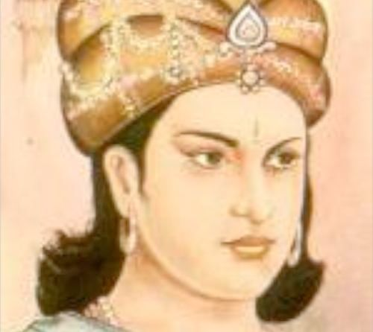
Chandragupta Unifies North India
Chandra seized all land from Magadha to Indus
Chandra began to fight against Seleucus (one of Alexander the Great’s successors) and won after several years
By 303 BCE, the Mauryan Empire stretched more than 2,000 miles
Chandra raised an army
Chandra’s government had to highly tax his people to raise his army

Slide 7
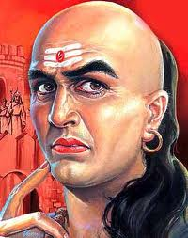
Running the Empire
Chandra relied on his advisor, Kautilya
Kautilya wrote a rule book, Arthasastra, that taught how to hold a vast empire together
Chandra created a highly bureaucratic government, with elected officials
Chandra divided his kingdom into provinces with individual princes

Slide 8
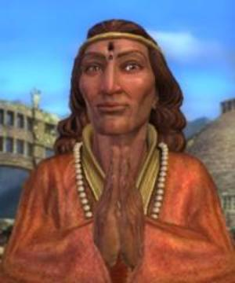
City Life and Country Life
Seleucus sent an ambassador to Chandra’s capital
In the ambassador’s letter he described the capital as:
Gold covered pillars
Numerous fountains
Thrones
Farmers are exempt from military service
You either serve in military or farm
Chandra’s son ruled for 32 years, and then his grandson, ASOKA took over and brought the empire to its greatest height

Slide 9
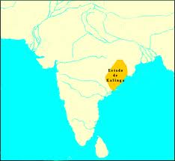
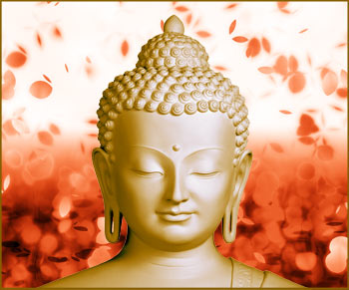
Asoka Promotes Buddhism
He waged war to expand his empire
After his bloody war against Kalinga, Asoka felt sorrow over the slaughter
“What have I done?”
He studied Buddhism and the non-violence teaching
Buddhism became the state religious c. 260 BCE
Sent missionaries throughout Asia to spread the religion

Slide 10
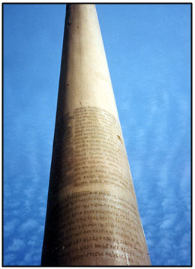
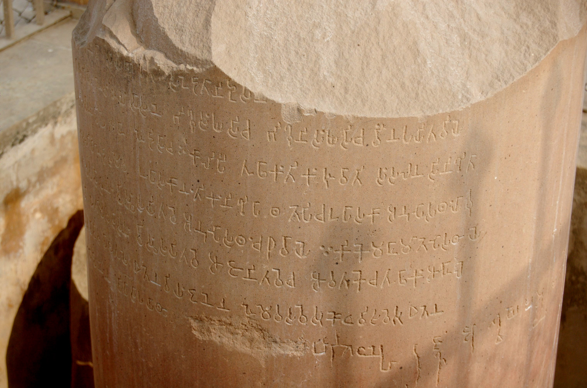
Asoka
Religious tolerance= acceptance of people who held different beliefs- and acceptance of people of all cultural backgrounds
Legacy
Had many pillars placed throughout his kingdom
Wrote laws and descriptions of proper behavior on pillars along roadsides throughout India.
Vegetarian- anti-hunting for sport

Slide 11
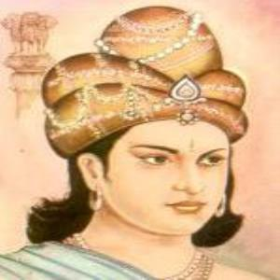
Edicts of Asoka
Asoka promoted
Nonviolence
Tolerance of all opinions
Obedience to parents
Respect for the religious teachers and priests
Liberality towards friends, humane treatment of servants
Generosity towards all
As noble as Asoka’s policies of toleration and nonviolence were, they failed to hold the empire together once Asoka was gone (When he died, the empire began to break up)

Slide 12
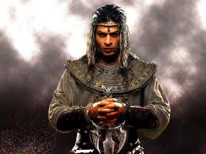
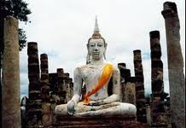
Asoka Promotes Buddhism
Asoka’s Advancements:
Extensive roads build so he could visit his whole kingdom
Roads improved communication throughout the vast empire
Planted trees along the road for people to rest under the shade
Dug wells along roads
What did this show? Asoka’s concern for his subject’s well-being

Slide 13
Asoka
https://www.youtube.com/watch?v=4GHe9mR4Zoc

Slide 14
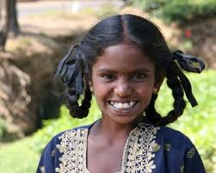
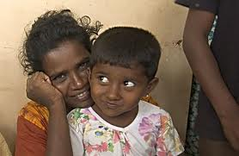
A Period of Turmoil
Asoka’s death left a power vacuum that was felt throughout the whole subcontinent
The next dynasty (Andhra) arose and dominated the region for hundreds of years
Northern India felt a flood of new people fleeing from political instability in other regions of Asia
For 500 years, Greeks, Persians, and Central Asians poured through the pass into northern India
These invaders, disrupted Indian society
Invaders introduced new languages and customs
In the South, the Tamil language and people ruled

