Slide 1
Preview of the Supreme Court
Notes:
Give brief background

Slide 2
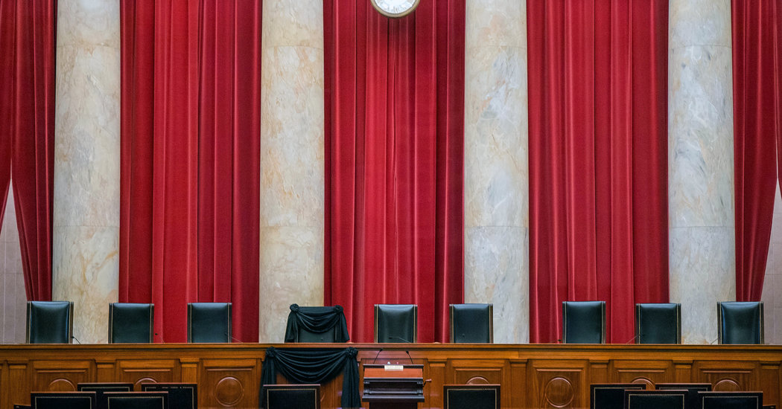
Find pic of Scalia’s chair draped
Notes:
This presentation and the dynamics of the court changed on Feb. 13, 2016

Slide 3
Current Court
Chief Justice John Roberts
Associate Justice Anthony Kennedy
Associate Justice Clarence Thomas
Associate Justice Ruth Bader Ginsburg
Associate Justice Stephen Breyer
Associate Justice Samuel Alito
Associate Justice Sonia Sotomayor
Associate Justice Elena Kagan
Notes:
Justices in order of seniority beginning with the Chief

Slide 4
Impact of Scalia’s passing
4-4 split
“Conservative”
Thomas
Roberts
Alito
Kennedy (depending on the issue)
“Liberal”
Ginsburg
Breyer
Sotomayor
Kagan
Notes:
Discuss 4-4 decisions – lower court’s ruling stands, but no precedent is set that all courts must follow
Also discuss stats about Scalia: authored 28 total opinions last term(3rd) – 9 majority (most), 15 dissenting (second most) – Thomas wrote most opinions – 37 total, 19 dissenting

Slide 5
vocab
Petitioner- is a person who pleads with governmental institution for a legal remedy or a redress of grievances, through use of a petition.
Respondent- person who replies to something, especially one supplying information for a survey or questionnaire or responding to an advertisement.
Notes:
For purposes of this, conservative = strict construction and liberal = liberal construction of Const

Slide 6
In this political climate…
“we were best buddies. We disagreed now and then, but when I wrote for the Court and received a Scalia dissent, the opinion ultimately released was notably better than my initial circulation.”
~ Justice Ruth Bader Ginsburg

Slide 7
Resources
www.streetlaw.org
www.oyez.org
www.scotusblog.com

