Slide 1
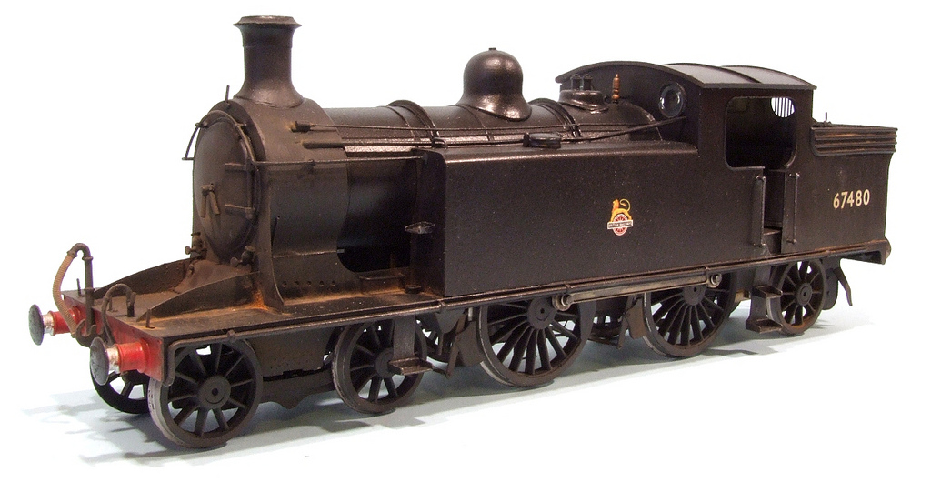
The Second
Industrial Revolution

Slide 2
Essential Question
What was the Second Industrial Revolution and what differentiated it from the First Industrial Revolution?

Slide 3
 | 1st Ind. Rev. | 2nd Ind. Rev.
Time Frame
Methods of Production
Mass Production
Power Sources
New Engines
Inventions
Standard of Living for working class
c. 1760-1830
c. 1850-1914
Hand → Machine
Increased Automation
Textiles
Steel (Bessemer Process)
Water, Coal, & Steam*
Petroleum & Electricity
Steam Engine*
Internal Combustion
Spinning Jenny
Water Frame
Spinning Mule
Cotton Gin
Automobiles
Chemicals
Railroads
Telegraph, Telephone, Radio
AWFUL
Think Tocqueville in Manchester
Still Bad, but improving
(Sewers, Sanitation, etc.)
Expansion of Middle Class
* Note that these technologies continued to be used during the 2nd IR but new sources of power were introduced, in addition.

Slide 4
WORLD EXPOSITIONS
1851-Present

Slide 5
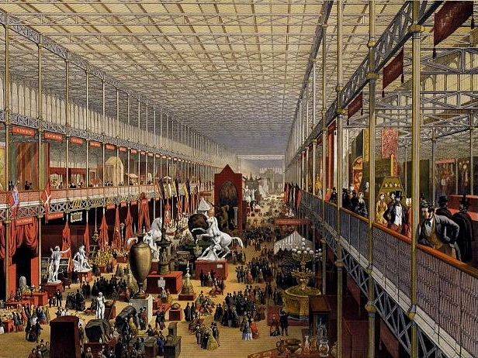
Crystal Palace Exhibition (1851)

Slide 6
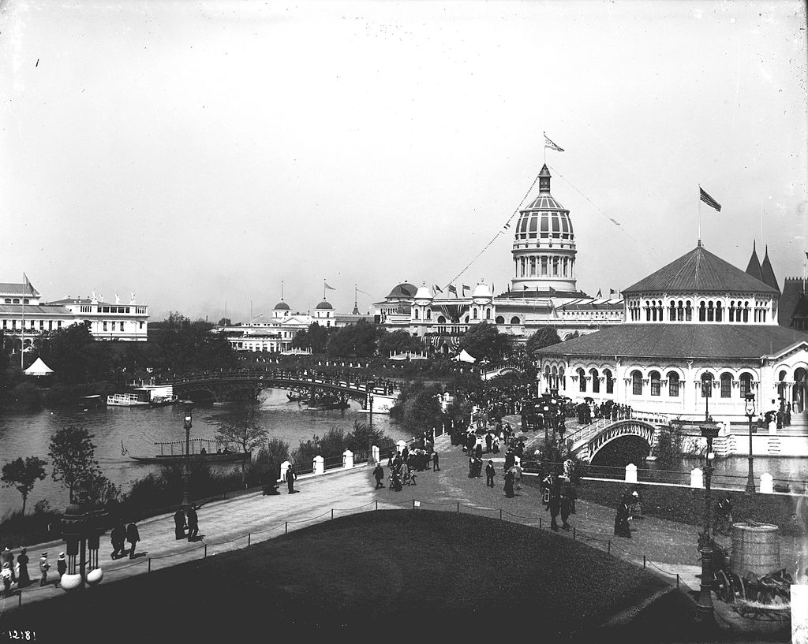
Columbian Exposition (1893)

Slide 7
2005

Slide 8
MILITARY TECHNOLOGIES
Comparing the First and Second Industrial Revolutions

Slide 9
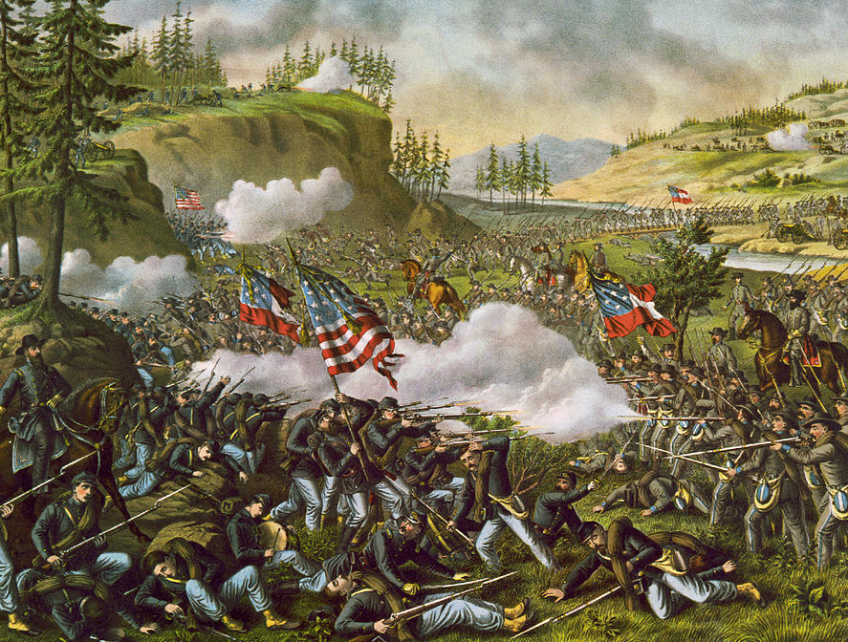

Slide 10
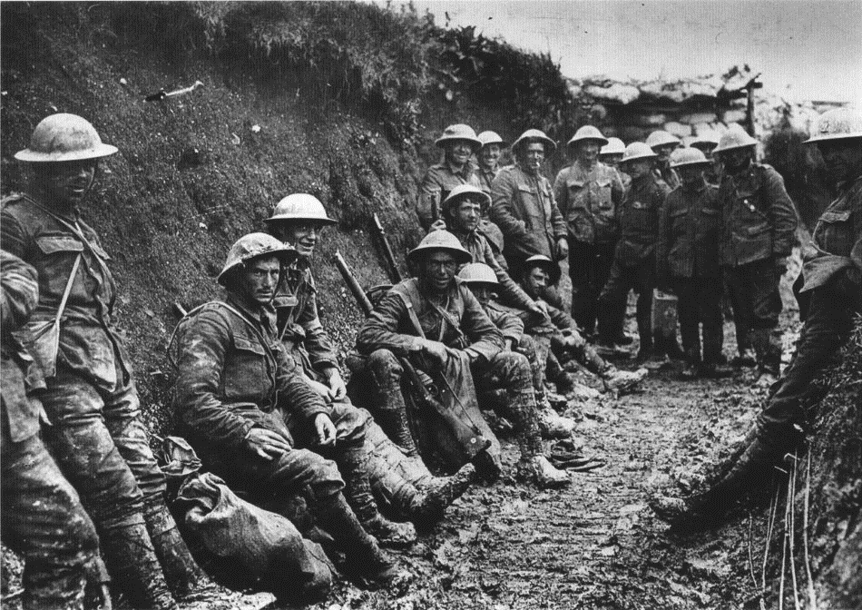

Slide 11
Spencer
Repeating
Rifle
(American Civil War)

Slide 12
Machine Gun (WWI)

Slide 13
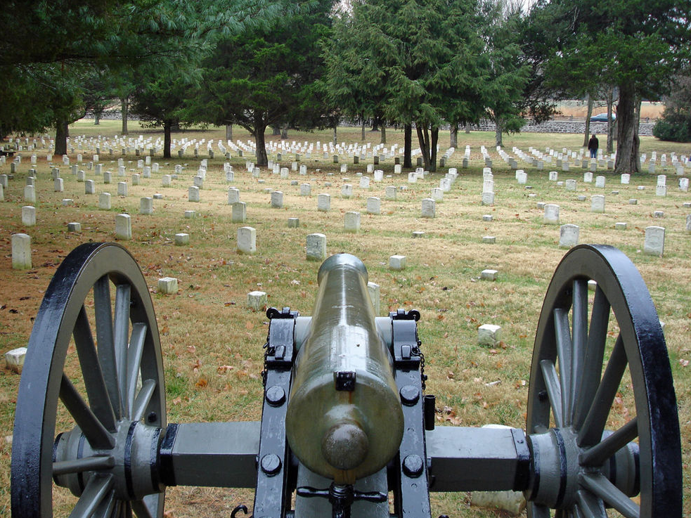
CIVIL WAR CANNON

Slide 14
WWI Artillery Piece

Slide 15
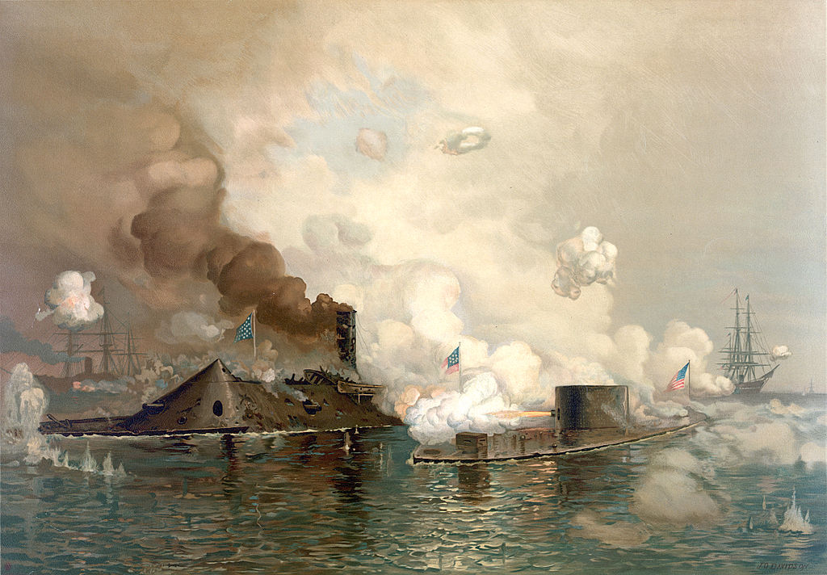
IRONCLADS

Slide 16
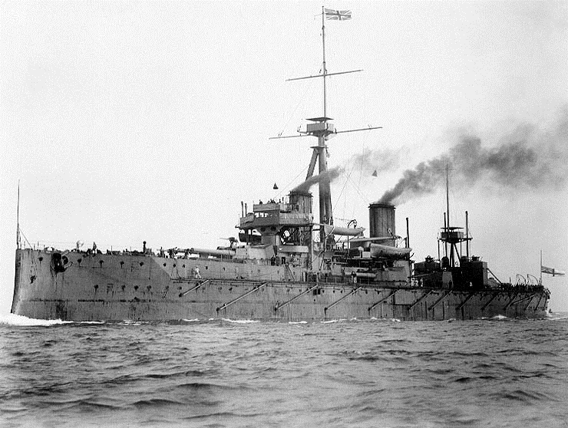
DREADNOUGHT

Slide 17
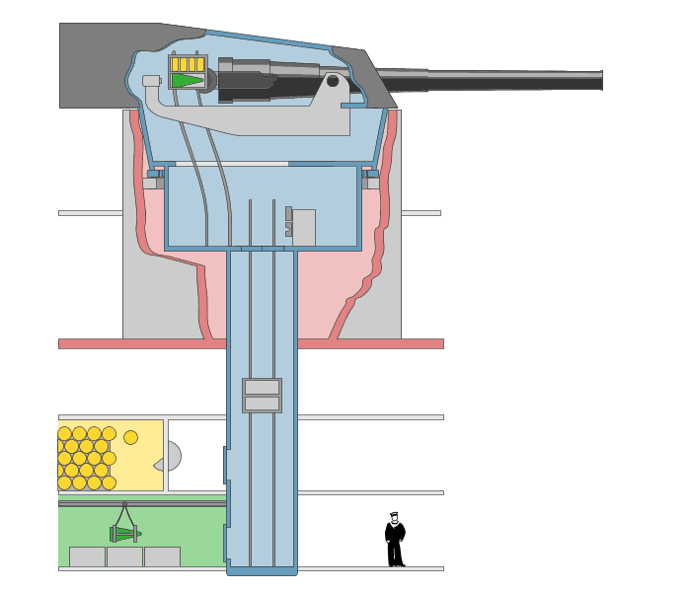
FULLY AUTOMATED
A Revolution in Weaponry

Slide 18
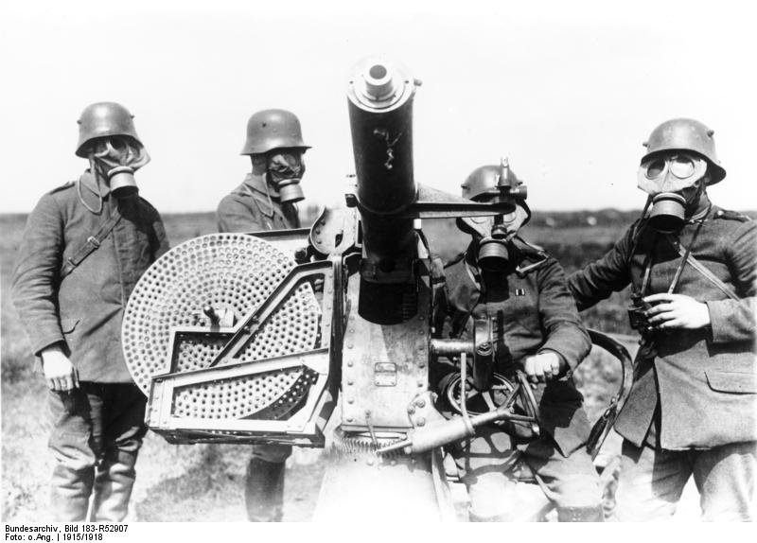

Slide 20
