Slide 1
How did Rome fall?

Slide 2
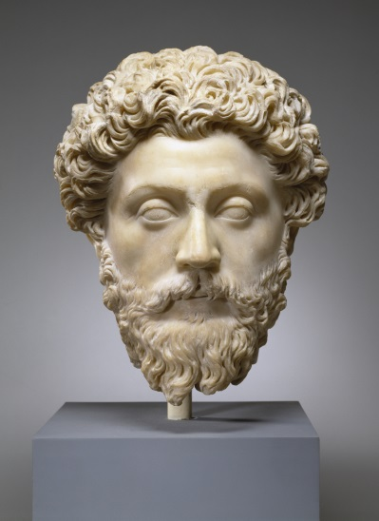
End of the Pax Romana
Marcus Aurelius (161-180 C.E.)
Last great Emperor for nearly 2 centuries
Economy Weakens
Overtaxed the land
Agriculture suffered because the soil was overused
Empire reached it’s limits
Rome was running out of resources
Military turmoil
Power struggles caused loyalty of army’s to change
Loyalty lies with the general not the emperor
Citizens no longer were loyal to the emperor

Slide 3
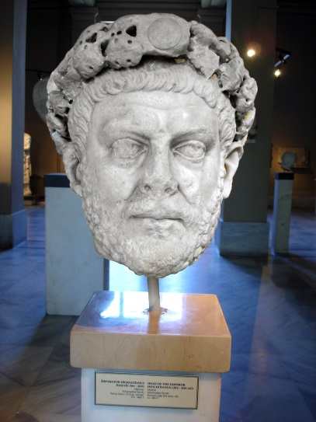
Diocletian
A powerful general gains power in 284 C.E.
Restored order to the empire and doubled the size of the army
Retires in 305 C.E. sending the Empire back into turmoil
Believed the empire had grown too large; split the empire into East (Greece, Anatolia, Syria, and Egypt) and West (Italy, Gaul, Britain and Spain)
The East was far wealthier than the West

Slide 4
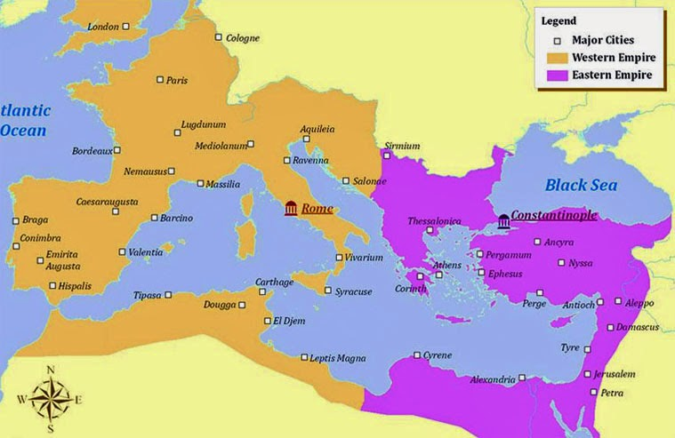

Slide 5
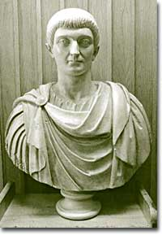
The Rise of Constantine
311 C.E. four rivals battle for power
312 C.E. Constantine takes control of the Western Empire
324 C.E. Constantine expands power of the Eastern Empire
330 C.E. moves capitol to Byzantium, in modern Turkey
Eventually re-named Constantinople

Slide 6
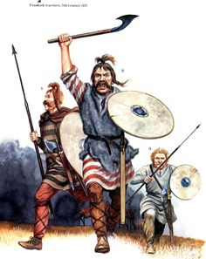
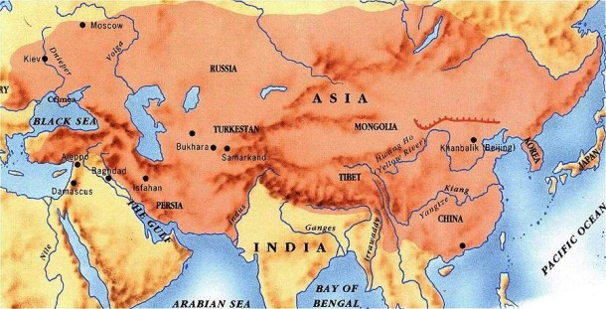
Decline of the West
Mongol’s (the Huns) invade Gaul in 370 C.E.
Germanic “barbarians” flee the Huns, pushing into Roman territory
410 C.E. German barbarians plunder Rome for three days

Slide 7
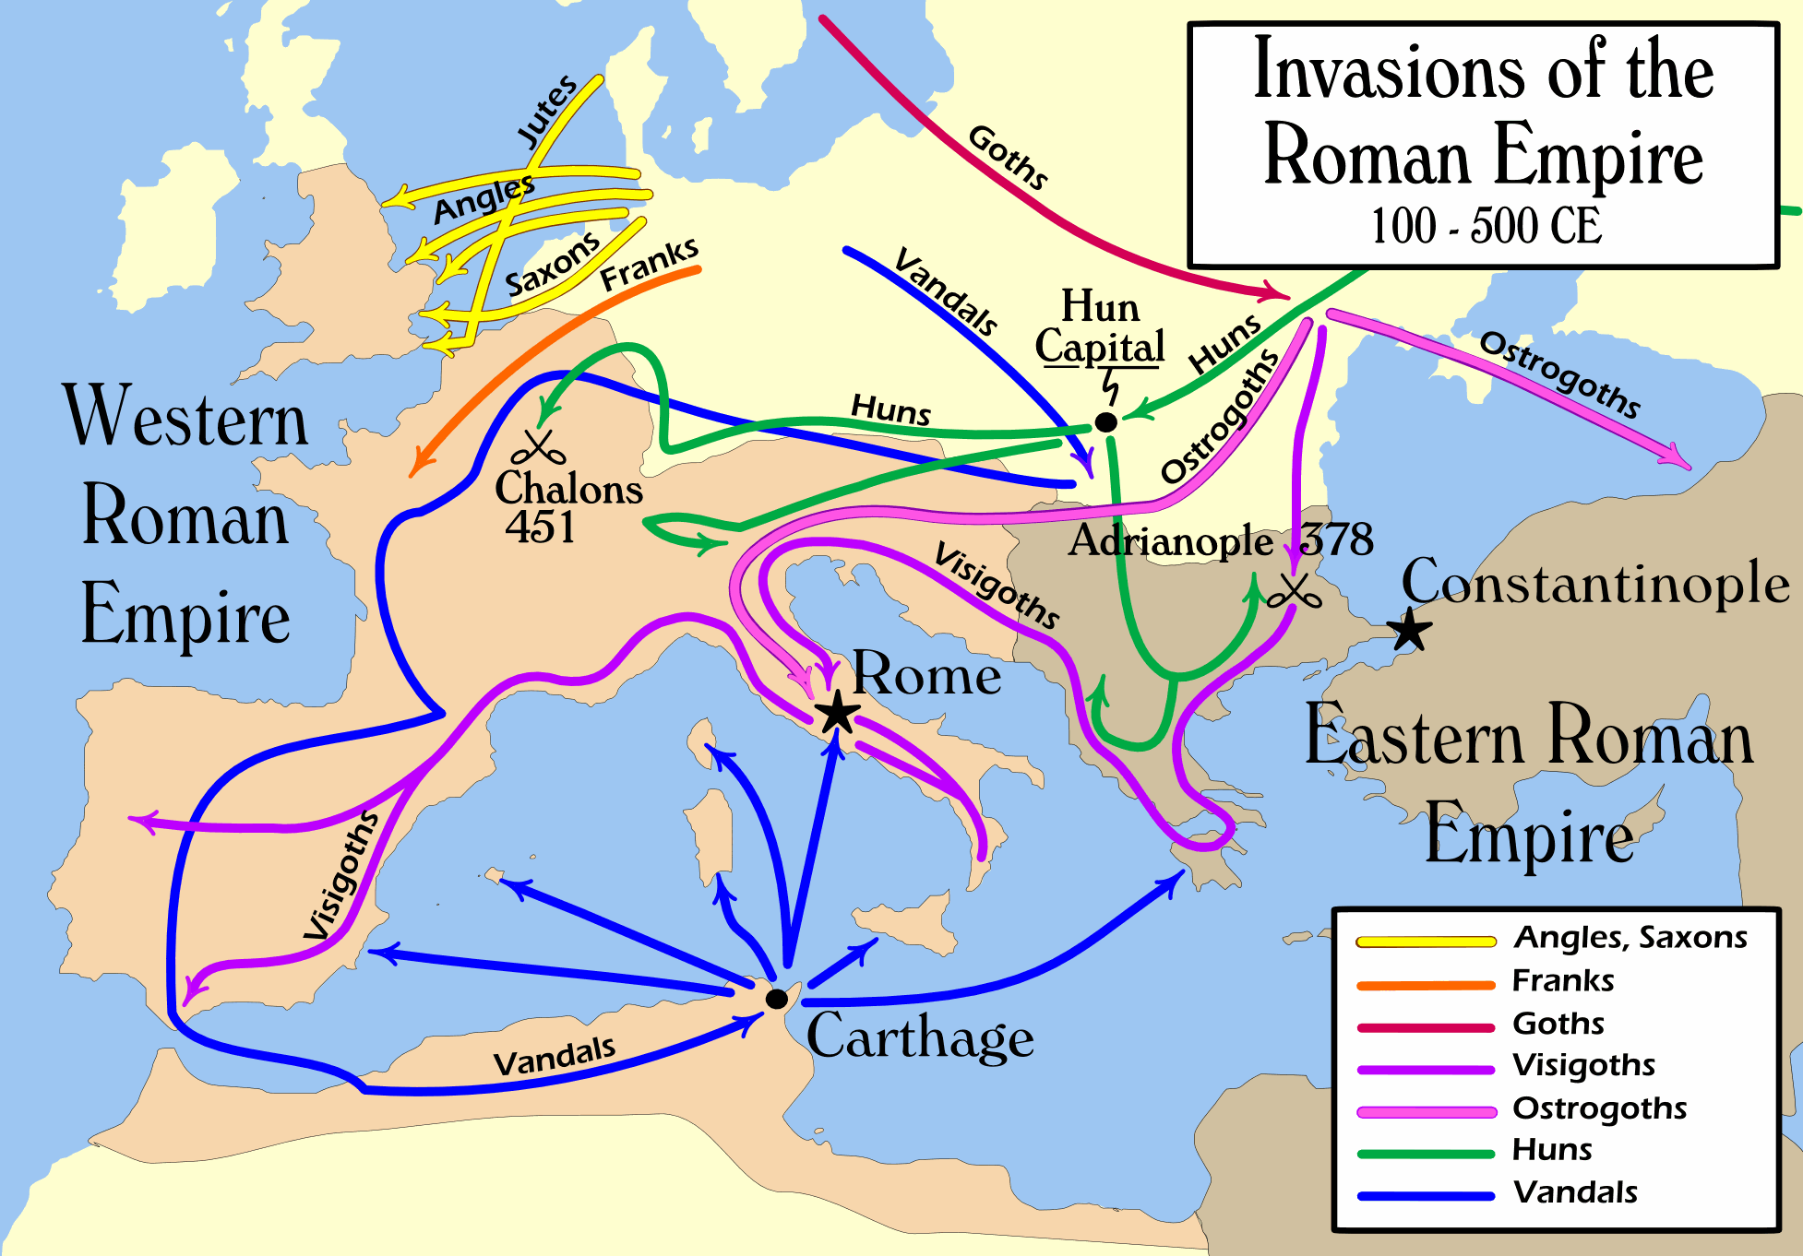

Slide 8
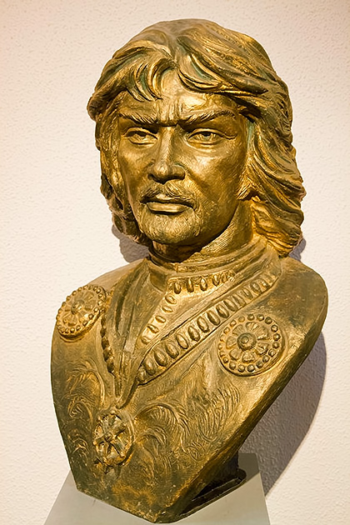
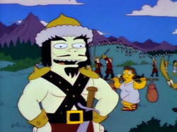
Attila the Hun
Unifies the Huns in 444 C.E.
Fails to take Constantinople
Marches on Rome in 452 C.E.
Famine and disease
Dies 453 C.E.
Ends Hun advances on Rome

Slide 9
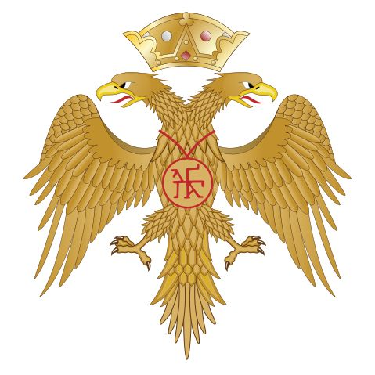
Eastern Empire
Eventually becomes the Byzantine Empire
Flourishes for nearly 1,000 years
They ruled from Constantinople and saw themselves as the heirs of the great Roman Emperors from the past

Slide 10
