Slide 1
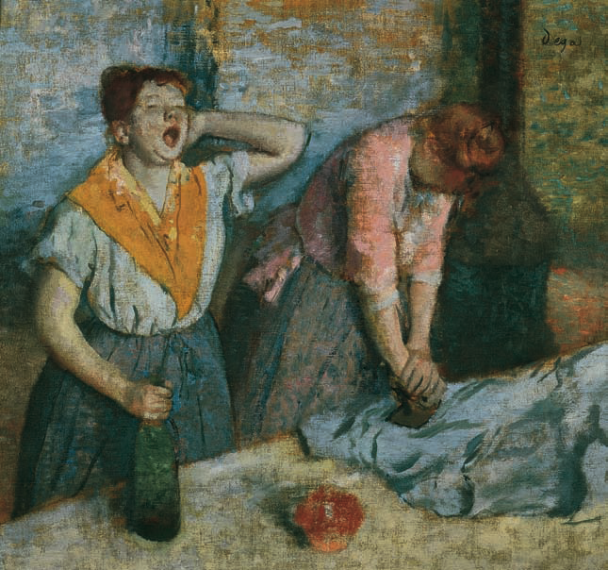
Chapter 23
The Building of European Supremacy:
Society and Politics to World War I
PART I

Slide 2
Population Trends and Migration
Population rises in Europe until 1910 when it levels off
Population rates continue to rise in underdeveloped nations and areas leading to food shortages
People continue to move from rural to urban areas
Between 1846 and 1932, 50 million Europeans leave their homeland to go to the United States, Canada, South Africa, Australia, Brazil and Argentina

Slide 3
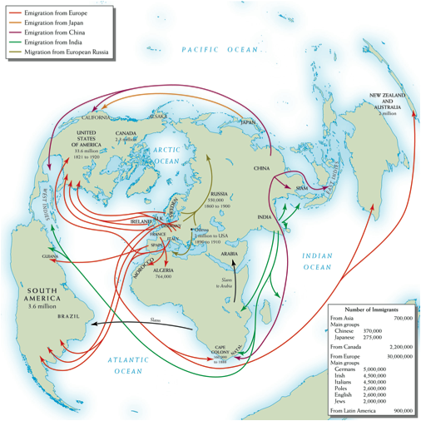
Emigration was a global process by the late 19th century. But more immigrants went to the United States than to every other nation combined.
Notes:
Map 23–1 PATTERNS OF GLOBAL MIGRATION, 1840–1900 Emigration was a global process by the late 19th century. But more immigrants went to the United States than to every other nation combined.

Slide 4
New Industries
New industries emerge in third quarter of the 19th century, leading to the Second Industrial Revolution
New industries included; steel, chemicals, electricity, and oil
Bessemer process – new way to mass produce steel cheaply revolutionizes the steel industry
Solway process – uses alkali production to make new soaps, dyes, and plastics
Electricity changes how people live and travel
Automobiles
Gottlieb Daimler – invents modern internal combustion engine, leading to automobiles
Henry Ford – American, who through the assembly line made the auto accessible to the masses
Autos lead to the growth of the oil industry

Slide 5
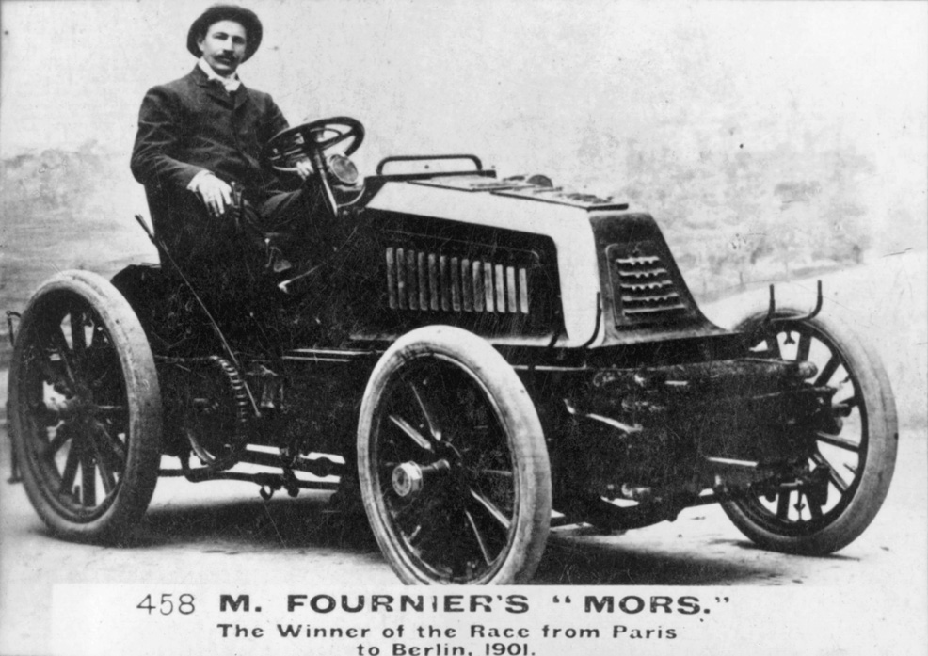
The invention and commercialization of automobiles soon led to auto races in Europe and North America. Here Henri Fournier, the winner of the 1901 Paris to Berlin Motor Car Race, sits in his winning racing car manufactured by the Paris-based auto firm of Emile and Louis Mors.
Notes:
The invention and commercialization of automobiles soon led to auto races in Europe and North America. Here Henri Fournier, the winner of the 1901 Paris to Berlin Motor Car Race, sits in his winning racing car manufactured by the Paris-based auto firm of Emile and Louis Mors.
Getty Images Inc.– Hulton Archive Photos

Slide 6
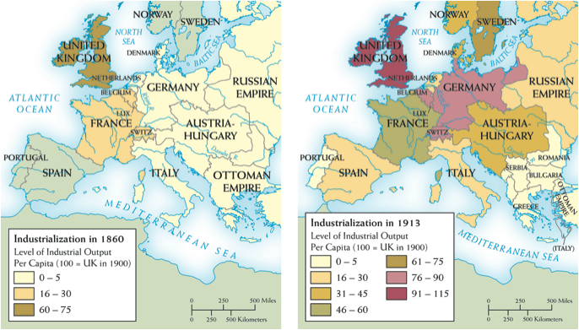
EUROPEAN INDUSTRIALIZATION, 1860–1913 In 1860 Britain was far more industrialized than other European countries. But in the following half century, industrial output rose significantly, if unevenly, across much of Western Europe, especially in the new German Empire. The Balkan states and the Ottoman Empire, however, remained economically backward.
Notes:
Map 23–2 EUROPEAN INDUSTRIALIZATION, 1860–1913 In 1860 Britain was far more industrialized than other European countries. But in the following half century, industrial output rose significantly, if unevenly, across much of Western Europe, especially in the new German Empire. The Balkan states and the Ottoman Empire, however, remained economically backward.

Slide 7
Economic Difficulties
Bad weather and foreign competition make it tough for European industries in the last quarter of the century
Stagnation, pockets of unemployment, bad working conditions, strikes and other forms of labor unrest emerge
Expansion of industry and consumer demand bring Europe out of stagnation by late in the century

Slide 8
Ascendancy in the Middle Class
Social distinctions of the middle class
Owners and managers – lived like an aristocracy
Comfortable small entrepreneurs and professional people (teachers, librarians, shopkeepers) – incomes permitted private homes and large quantities of furniture, education and vacations
“White collar workers” – formed lower middle class – petite bourgeoisie – such as secretaries, retail clerks, lower level bureaucrats – spent money on consumer goods that made sure to make them look middle class
Tensions mount up between the classes

Slide 9
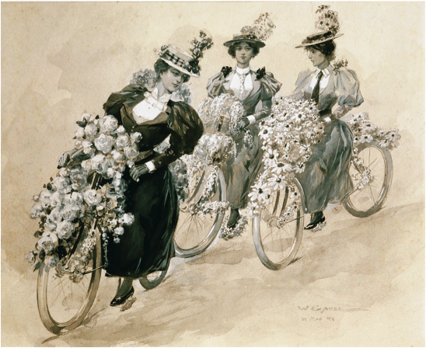
The bicycle helped liberate women’s lives, but as this poster suggests, it also was associated with glamour and fashion.
Notes:
The bicycle helped liberate women’s lives, but as this poster suggests, it also was associated with glamour and fashion.
© Archivo Iconografico, S.A./CORBIS

Slide 10
The Redesign of Cities
The New Paris
Paris rebuilt for political purposes – to discourage riots and accommodate the creation of thousands of government jobs
Department stores, office complexes, apartments for the middle class, and a subway are built
Arts and architecture – Paris Opera,
Eiffel Tower, and Basilica of
the Sacred Heart built
Suburbs – to get away from the
congestion of the city, many middle-class
residents move to communities just
outside the urban centers

Slide 11
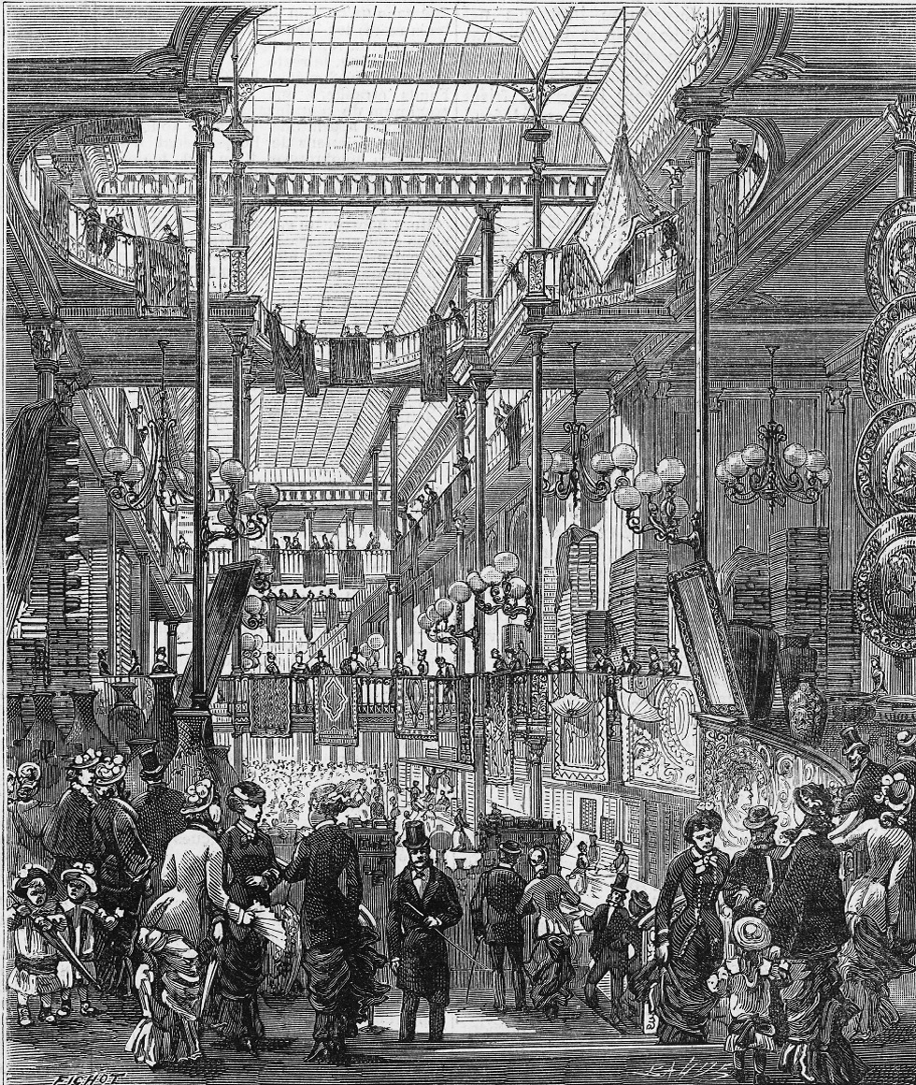
Department stores, such as Bon Marche in Paris, sold wide selections of consumer goods under one roof. These modern stores increased the economic pressure on small traditional merchants who specialized in selling only one kind of good.
*(Look at “Paris Department Stores Expand their Business,” page 766.)
Notes:
Department stores, such as Bon Marche in Paris, sold wide selections of consumer goods under one roof. These modern stores increased the economic pressure on small traditional merchants who specialized in selling only one kind of good. (See “Paris Department Stores Expand their Business,” page 766.)
Image Works/Mary Evans Picture Library Ltd.

Slide 12
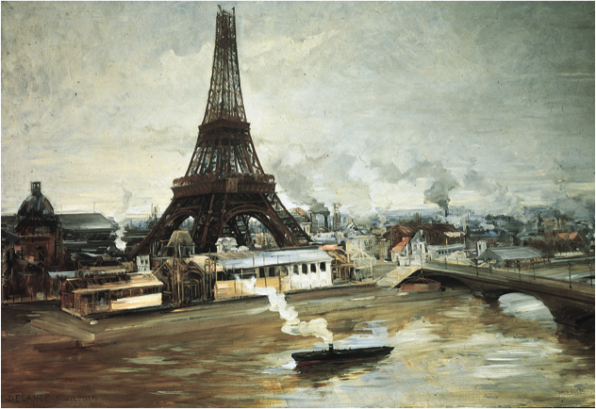
The Eiffel Tower, shown under construction in this painting, was to become a symbol of the newly redesigned Paris and its steel structure a symbol of French industrial strength.
Notes:
The Eiffel Tower, shown under construction in this painting, was to become a symbol of the newly redesigned Paris and its steel structure a symbol of French industrial strength.
Getty Images, Inc.—Liaison

Slide 13
Urban Sanitation
Cholera – believed to be caused by filth and smell, touched all classes and reached epidemic proportions in 1830’s and 1840’s
Water and sewer systems – disposed of human waste and provided clean drinking water
Government involvement in public health
Private property could be condemned if deemed unhealthy
New building regulations

Slide 14
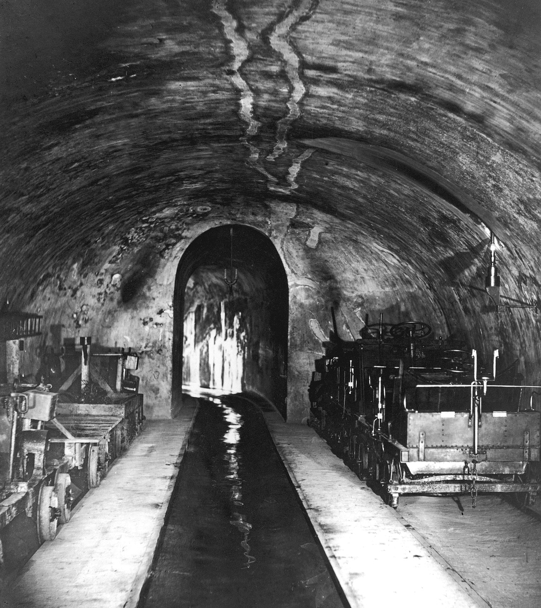
A major feature of the reconstruction of mid-nineteenth-century Paris under the Emperor Napoleon III was a vast new sewer system to provide for drainage in the city. Sewer workmen could travel the length of the structure on small rail cars. Even today tourists still may visit parts of the mid-city Paris sewer system.
Notes:
A major feature of the reconstruction of mid-nineteenth-century Paris under the Emperor Napoleon II was a vast new sewer system to provide for drainage in the city. Sewer workmen could travel the length of the structure on small rail cars. Even today tourists still may visit parts of the mid-city Paris sewer system.
Nadar/Getty Images

Slide 15
Housing Reform / the Middle Class
Middle class reformers believed cheap, adequate housing would alleviate social and political discontent
Private philanthropy attacked the housing problem

Slide 16
Barriers for Women in Late 19th Century
Property – until last quarter of century – most women in Europe could not own property; everything was in their husband’s name – only Britain changed this in 1882 with the Married Women’s Property Act
Family law – divorce was difficult to obtain, men had legal control of the children, and contraception and abortion were illegal
Education
Could not attend universities until late 19th century
Absence of secondary education for women
Women with professional jobs were considered radicals and faced discrimination

Slide 17
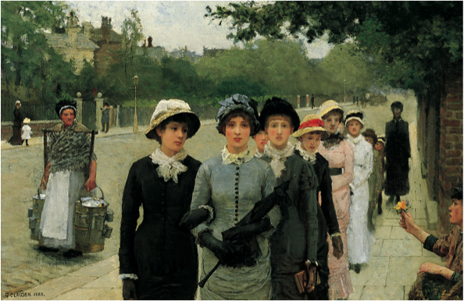
Women only gradually gained access to secondary and university education during the second half of the nineteenth century and the early twentieth century. Young women on their way to school, the subject of this 1880 English painting, would thus have been a new sight when it was painted.
Notes:
Women only gradually gained access to secondary and university education during the second half of the nineteenth century and the early twentieth century. Young women on their way to school, the subject of this 1880 English painting, would thus have been a new sight when it was painted.
Sir George Clausen (RA) (1852–1944), “Schoolgirls, Haverstock Hill,” signed and dated 1880, oil on canvas, 20 × 30 in. (52 × 77.2 cm), Yale Center for British Art/Paul Mellon Collection, USA/Bridgeman Art Library (B1985.10.1). Courtesy of the Estate of Sir George Clausen

Slide 18
New Employment for Women
New jobs – included secretaries, clerks, and shop assistants / still paid low wages
Withdrawal from labor force – married women less and less in work force due to:
Industries preferring unmarried women
Men living longer
Social expectations of the married women

Slide 19
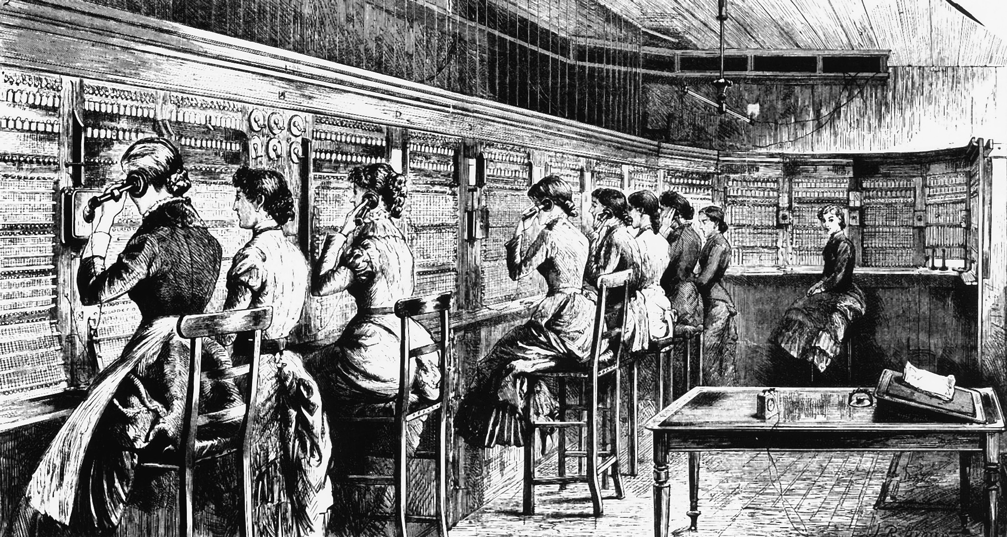
Women working in the London Central Telephone Exchange. The invention of the telephone opened new employment opportunities for women.
Notes:
Women working in the London Central Telephone Exchange. The invention of the telephone opened new employment opportunities for women.
Image Works/Mary Evans Picture Library Ltd.

Slide 20
Working-Class Women
Putting-out system – manufacturer would purchase material, then put it out to the tailors
Subject to layoffs when demand for products slowed
Had low wages and subject to exploitation

Slide 21
Prostitution
Women displaced in an overcrowded work force turned to prostitution
Most large 19th-century cities had legal prostitution
Usually low-skill workers with little education; customers were working class men

Slide 22
Middle Class Women
Domesticity – oversaw virtually all the domestic management and child care
Religion – assured the religious instruction of their children and prayer was a major part of their daily lives
Charity – worked with poor youth, poor young women, schools for infants, and societies for visiting the poor
Sexuality – less sexual repression, and due to contraceptives and the cost of having children, smaller families

Slide 23
Rise of Feminism
Obstacles – many women did not support the feminist movement because
Sensitivity to class and economic interests
Cared more about national unity and patriotism
Religious women uncomfortable with radical secularists
Women’s suffrage in Britain – suffrage – the movement for women to vote
Millicent Fawcett – led the moderate National Union of Women’s Suffrage Societies
Emmeline Pankhurst – led the more radical Women’s Social and Political Union, which encouraged strikes, arson, and vandalism
Women given right to vote in Britain in 1918
Political feminism – women granted right to vote in France (after World War II) and Germany (1919)
Union of German Women’s Organizations – founded in 1894, supported suffrage, but more concerned about education, social, and political conditions

Slide 24
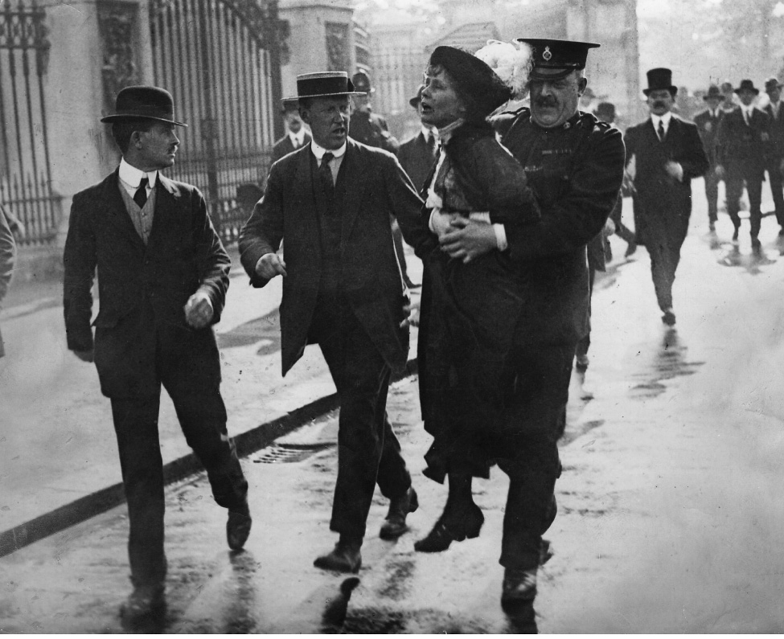
Emmeline Pankhurst (1857–1928) was frequently arrested for forcibly advocating votes for British women.
Notes:
Emmeline Pankhurst (1857–1928) was frequently arrested for forcibly advocating votes for British women.
Hulton Archive Photos/Getty Images Inc.

